Slide 1
Leveraging Azure PaaS and Serverless to deliver business innovation
Technical Bootcamp
Ahmed Sabbour
Technology Solution Professional OSS Application Development (Containers + DevOps) Global Black Belt

Slide 2
Agenda
9:00
10:30
11:00
13:30
14:30
16:30
Scenario overview
Technology overview
[Coffee Break]
Preparing and deploying the solution
Importing APIs into Azure API Management
[Lunch Break]
Connecting solution with Logic Apps
Testing the solution and final thoughts
Finish

Slide 3
Learning objectives
At the end of this session, you will:
Learn how to utilize cloud services to modernize a traditional business application to drive customer value.
Learn how to use Azure API Management, Logic Apps, Web Apps, Azure Functions and Cognitive Services.
Be able to demonstrate an end-to-end application modernization scenario to your customers.

Slide 4
Scenario overview
A customer submits spoken feedback on your website
Cognitive Speech APIs convert speech to text
Feedback is submitted to the system and stored
Perform a sentiment analysis on the feedback
Retrieve the customer details via your backend
If feedback was negative, generate a discount coupon
Send the coupon via email

Slide 5











Solution diagram
Sentiment Analysis Cognitive Services
API Management
Storage Queue
Speech Recognition Cognitive Services
Feedback Web (.NET Core) Web App on Windows
Logic App
Customer Details API (PHP) Web App on Linux
Feedback Data CosmosDB
Coupon Generator (Node.JS) Azure Function
Customer Data Azure Database for MySQL
Content Delivery Azure CDN
Blob Storage

Slide 6
Azure App Service

Slide 7


Azure App Service
Enterprise-grade apps
Fully managed platform
High productivity development
Global data center footprint
Hybrid support
Built-in auto scale and load balancing
High availability with auto-patching
.NET, Java, PHP, Node,
Ruby, and Python
Staging and deployment
AAD integrated
Secure + compliant
Reduced operations costs
Backup and recovery
Testing in production
App gallery marketplace

Slide 8

App Service
From on-premises to the cloud
AZURE APP SERVICE (MULTI-TENANT)
Get your Web, API, or Mobile App created in seconds in the cloud. We provide the infrastructure, you provide your application code.
AZURE APP SERVICE (ISOLATED)
Run your apps in virtual network at high scale. Manage all of the resources behind your public endpoint creating an isolated environment specifically for your organization.
AZURE STACK
Leverage cloud innovations in on-premises infrastructure. App Service on Azure Stack brings the power of Azure App Service to your own data centers.

Slide 9
























450K active customers | 1.2M apps & sites hosted |>13B requests per day
AGRICULTURE, FORESTRY, AND, FISHING
DISCRETE MANUFACTURING
EDUCATION
GOVERNMENT
HEALTH
HOSPITALITY AND TRAVEL
Digital destination to support 20M hits and fuel more innovation
Get a new auction site up and running faster than ever
Azure App Services as a platform for modern apps
Self-help administration apps are hosted by Azure App Service on Azure Government
Turning a discovery into a marketable product easily
Use Azure App Service to rewrite its learning platform
BANKING AND CAPITAL MARKETS
Crowdsourcing gets music from the cloud to the concert hall
Move solutions to Azure App Services and to explore product development in the cloud
Hong Kong’s largest pizza chain goes cloud and grabs a bigger slice of the market
Analyzes how kids learn, delivers 10x speed improvement
Developers take advantage of Web App to boost innovation and savings
Highly scalable cloud service
INSURANCE
NONPROFIT
MEDIA AND CABLE
POWER AND UTILITIES
PROFESSIONAL SERVICES
RETAIL AND CONSUMER GOODS
Back-end infrastructure includes Azure App Service integrated with Node.js
Canadian broadcaster delivers record-breaking online election coverage
Azure App Services tools to include worksheet data within Reactive
Insurance firm transforms online services
Big data and cloud technologies safeguard lives and businesses worldwide with Azure App Services
Azure App Service handles the dynamic resizing of images
TELECOMMUNICATIONS
PROCESS MANUFACTURING AND RESOURCE
Pioneer insurance model with speedy implementation
Serving the latest tech news to 2 million readers worldwide
Keeps tails wagging with help from Azure App Services
Azure App Services scale automatically for its consumer front end
Azure App Services cuts time-to-market by 40%
Transforms onboarding with Azure App Services
Notes:
Momentum data captured June 2017.

Slide 10
Recent App Service announcements
Web App for Containers (Linux) – GA
Run on native Linux platform and bring your own containers
App Service Environment v2 (Isolated) – GA
VNet integration, easier deployment than v1, faster VMs (Dv2)
App Service Premium v2 – GA
Faster VMs (Dv2) with higher ram to core ratio than Standard tier

Slide 11

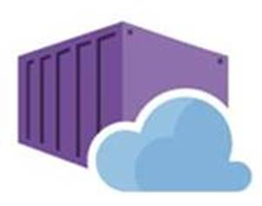

Web App comes to Linux in two forms
Bring your code
Bring your container

Slide 12

Web app for containers
High productivity development
Fully managed platform
Enterprise-grade apps
Deployment
with ease
CI/CD build
and deploy
Built-in auto scale and load balancing
High availability with auto-patching
Global data center footprint
Private registry
support
Testing in production
Staged deployment
with slots
Monitoring
and diagnosis
Backup and recovery
AAD integrated
Secure + compliant

Slide 13



Incoming HTTP Traffic
Configuration DBs
Data Cache
Frontend Load Balancers
App Service Scale Unit
CRUD API Calls
File Servers
Linux Workers
REST API Endpoint
Publishing Calls
Publishers
Container Image Repository
Windows Workers

Slide 14
Linux Worker
Bridge 1
Bridge 2
Proxy
App 1 Container
App 2 Container
SCM 2 Container
Incoming HTTP Traffic
SSH
Orchestrator
SCM 1 Container
Security & Audit Service
Metadata From SQL
Local Container Cache
Manage
Persistent Site Content Mounts
Monitoring & Logging Service

Slide 15

App Service Isolated
Layered security
Enterprise scale
Hybrid connectivity
Network isolation
App lock down
Built-in auto scale and load balancing
Upgraded CPU
and capacity
Point to site VPN
Hybrid connections
AAD integrated
Application
Gateway
Global data center footprint
High availability with auto-patching
Express routes
VNET integration

Slide 16
Azure API Management

Slide 17
What’s in common?
Internet
of
Things
Machine
Learning
Mobile
APIs
Software
as a
Service
Cloud
Computing
Blockchain

Slide 18



Strategic value of APIs
User engagement
Ecosystems
Multi-modal IT
Mobility
User experience
Crowdsourcing
Business models
Channels
Ecosystems
Agility
Empowerment
Productivity
Based on Gartner research note “Articulating the Business Value of APIs”
Anne Thomas and Kristin R. Moyer
24 March 2016

Slide 19









API Management - a hub for enterprise APIs
Discover
Learn
On-board
Try
Get support
SDKs and samples
1st and 3rd party apps
Abstract
Secure & protect
Evolve
Monitor
Analyze
Productize
Monetize
Consume
Mediate
Publish
Developer portal
Gateway
Azure portal
API managers and developers
App developers
APIs on Azure and outside

Slide 20


















CUSTOM ANALYTICS
CUSTOM REPORTS & DASHBOARDAS
NETWORKING
BACKEND
APIs
WAF
IDENTITY

Slide 21
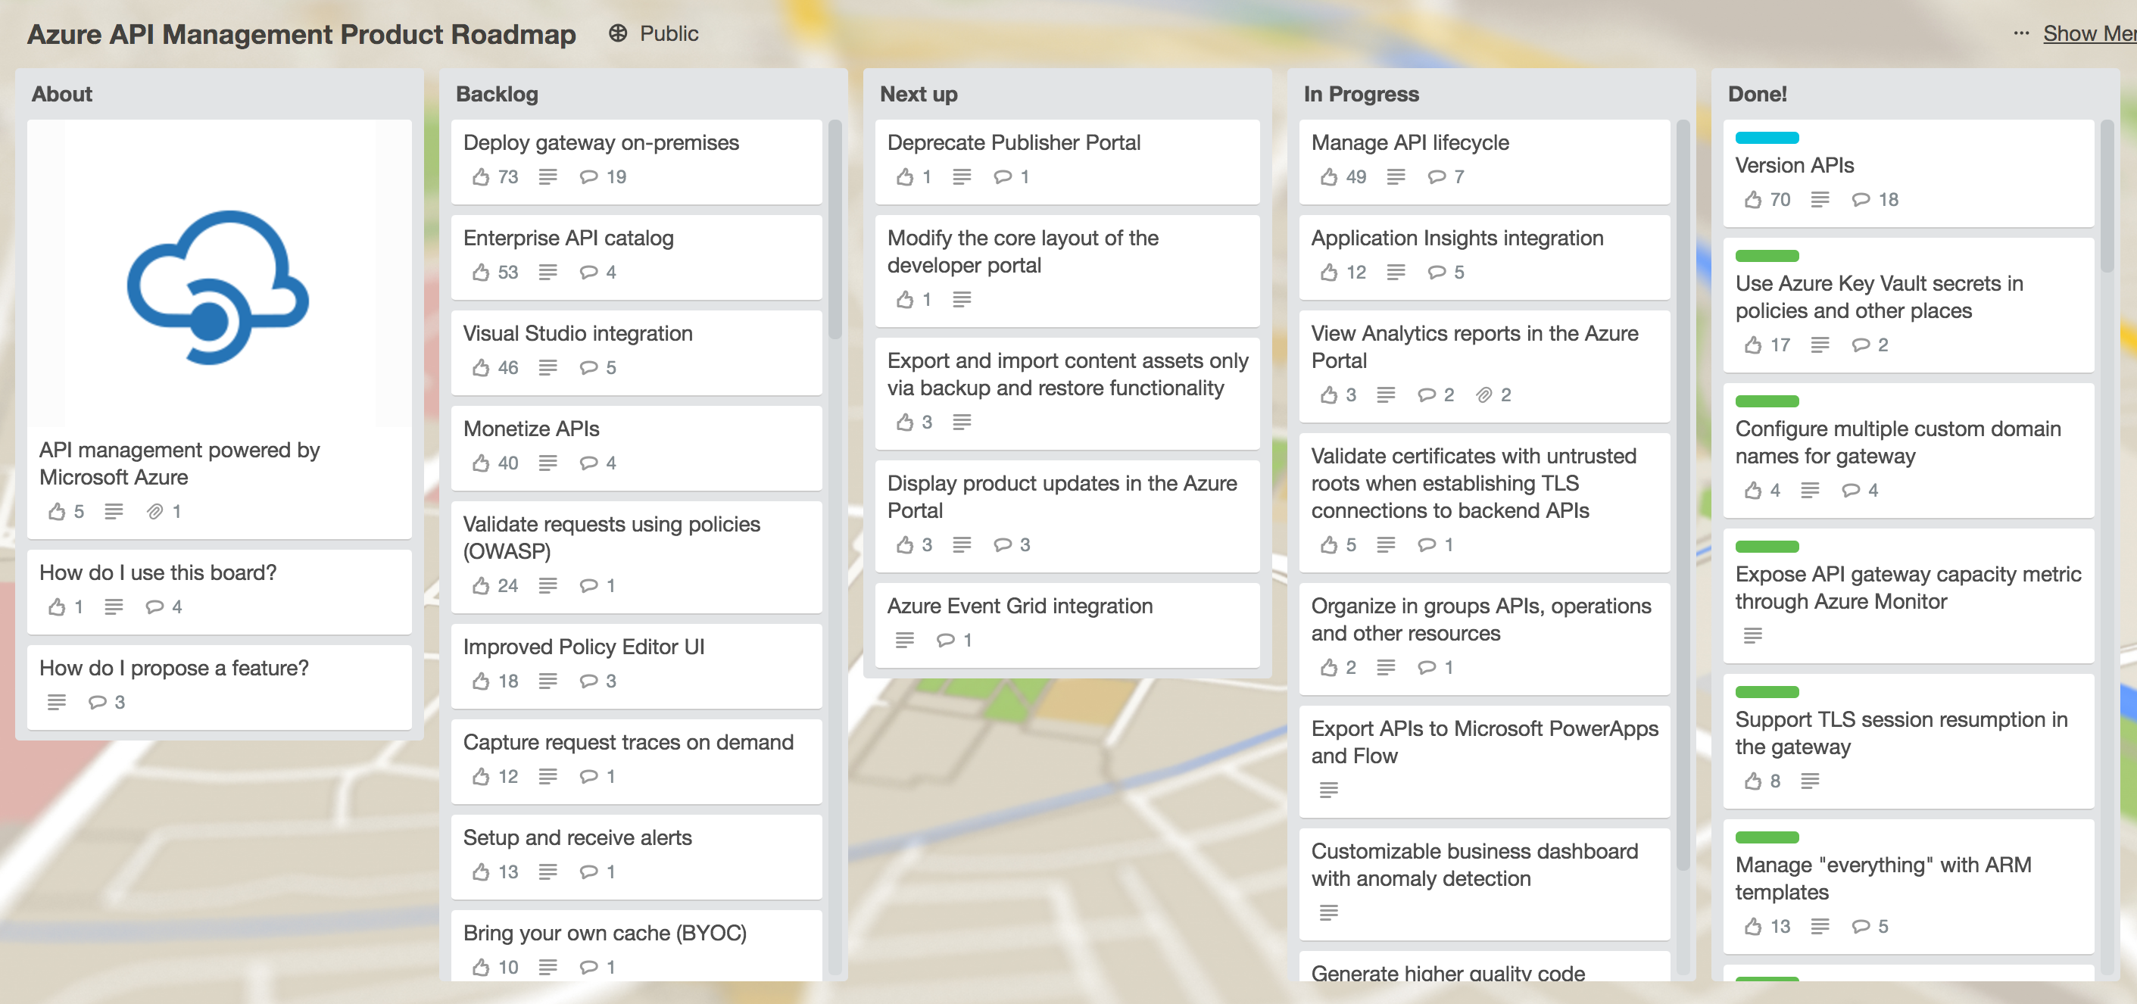
Recent API Management announcements
API Versioning – Preview
Use Azure Key Vault secrets– GA
Configure multiple custom domain names – GA
Expose API gateway capacity through Azure Monitor – GA
Azure API Management PowerBI Solution Template - GA
http://aka.ms/apimroadmap

Slide 22
Azure Functions

Slide 23
What is Serverless?
$
Abstraction of servers
Event-driven/ instant scale
Micro-billing

Slide 24
Benefits of Serverless
Reduced DevOps
Focus on business logic
Faster time to market

Slide 25


Serverless application platform components
Development
Platform
IDE support
Functions
Logic apps
Developer tooling
Bindings and triggers
Code (C#, JS, F#)
Visual designer
100+ connectors
Functions orchestration
Visual debug history
Local development
Data/storage
Messaging
Gateway Connectors
Intelligence
Bots
Verbose debugging

Slide 26

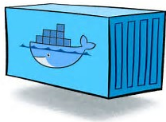

Private Cloud and Edge
Large, medium and small edges
App Service Environment
A Virtual Private Cloud SKU allowing for Functions to run in an App Hosting Plan. ASE provides network and resource isolation for large workloads. We are planning a v2.0 launch under the “isolated” brand name.
Azure Stack
App Service on Azure Stack brings the power of Azure App Service to your own data centers. Azure Functions are available on Azure Stack in an App Hosting Plan.
Azure Functions Runtime
Azure Functions available on Windows Containers with minimal manageability features.

Slide 27
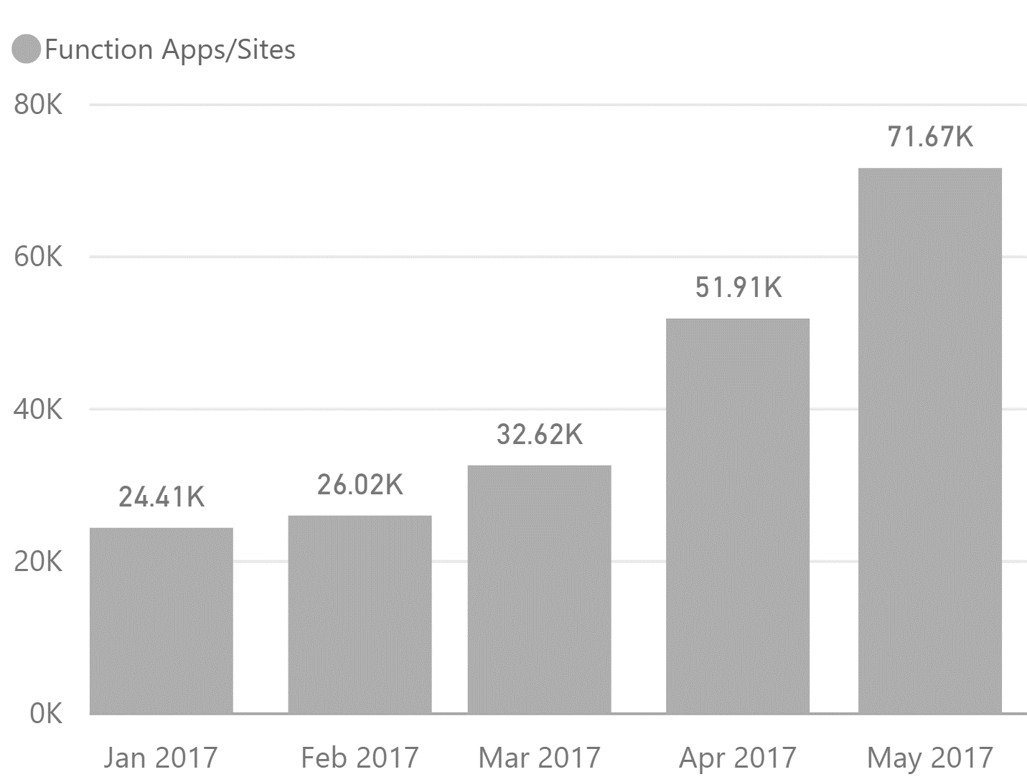
Functions Metrics
18.5 Billion
Monthly executions
Traffic (1 mo) | Name
11,476,043,314 | BOEING COMPANY
562,432,824 | REALOGY CORPORATION
416,187,533 | UNIVERSAL ELECTRONICS INC
415,186,776 | ASURION INSURANCE SERVICES
351,796,394 | MYOB LIMITED
257,368,203 | BillerudKorsnäs AB
182,642,342 | CARMAX INC
170,339,973 | BANCO SANTANDER
152,897,247 | DELL
134,605,861 | THOMSON CORPORATION

Slide 28
Use bindings in your code
run.csx
function.json
public static void Run(byte[] image, string filename,
Stream outputBlob, TraceWriter log)
{
log.Info($"Processing image: {filename}");
var imageBuilder = ImageResizer.ImageBuilder.Current;
imageBuilder.Build(
image, outputBlob,
new ResizeSettings(640, 400, FitMode.Max, null), false);
}
{
"bindings": [
{
"name": "image",
"type": "blobTrigger",
"direction": "in",
"path": "card-input/{filename}.jpg",
"connection": "AzureWebJobsStorage"
},
{
"type": "blob",
"name": "outputBlob",
"path": "card-output/{filename}.jpg",
"connection": "AzureWebJobsStorage",
"direction": "out"
}
]
}

Slide 29
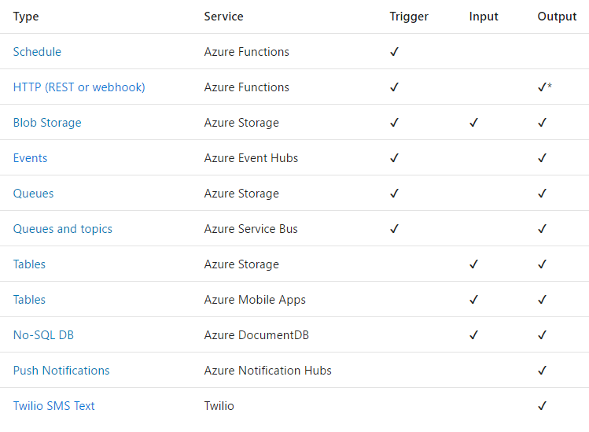
Triggers and Bindings

Slide 30
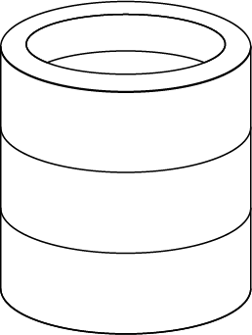






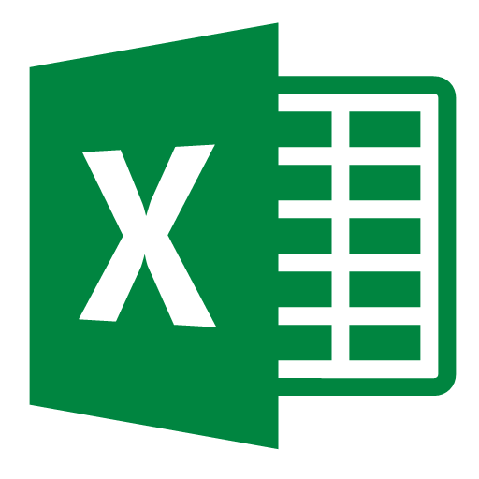

Developer productivity – new bindings
Azure Active Directory access token
Common Data Service
Microsoft Graph
(Starting with Office)
Other Services
Get a token to any AAD resource
Support for user or app identity
Query support
Full capability of the CDS SDK (for C#)
React to Graph events via webhooks
Easy integration and binding to Graph SDK types
Extensibility model allows us to easily onboard new partners
Eventually will be open to all developers

Slide 31
Azure Logic Apps

Slide 32
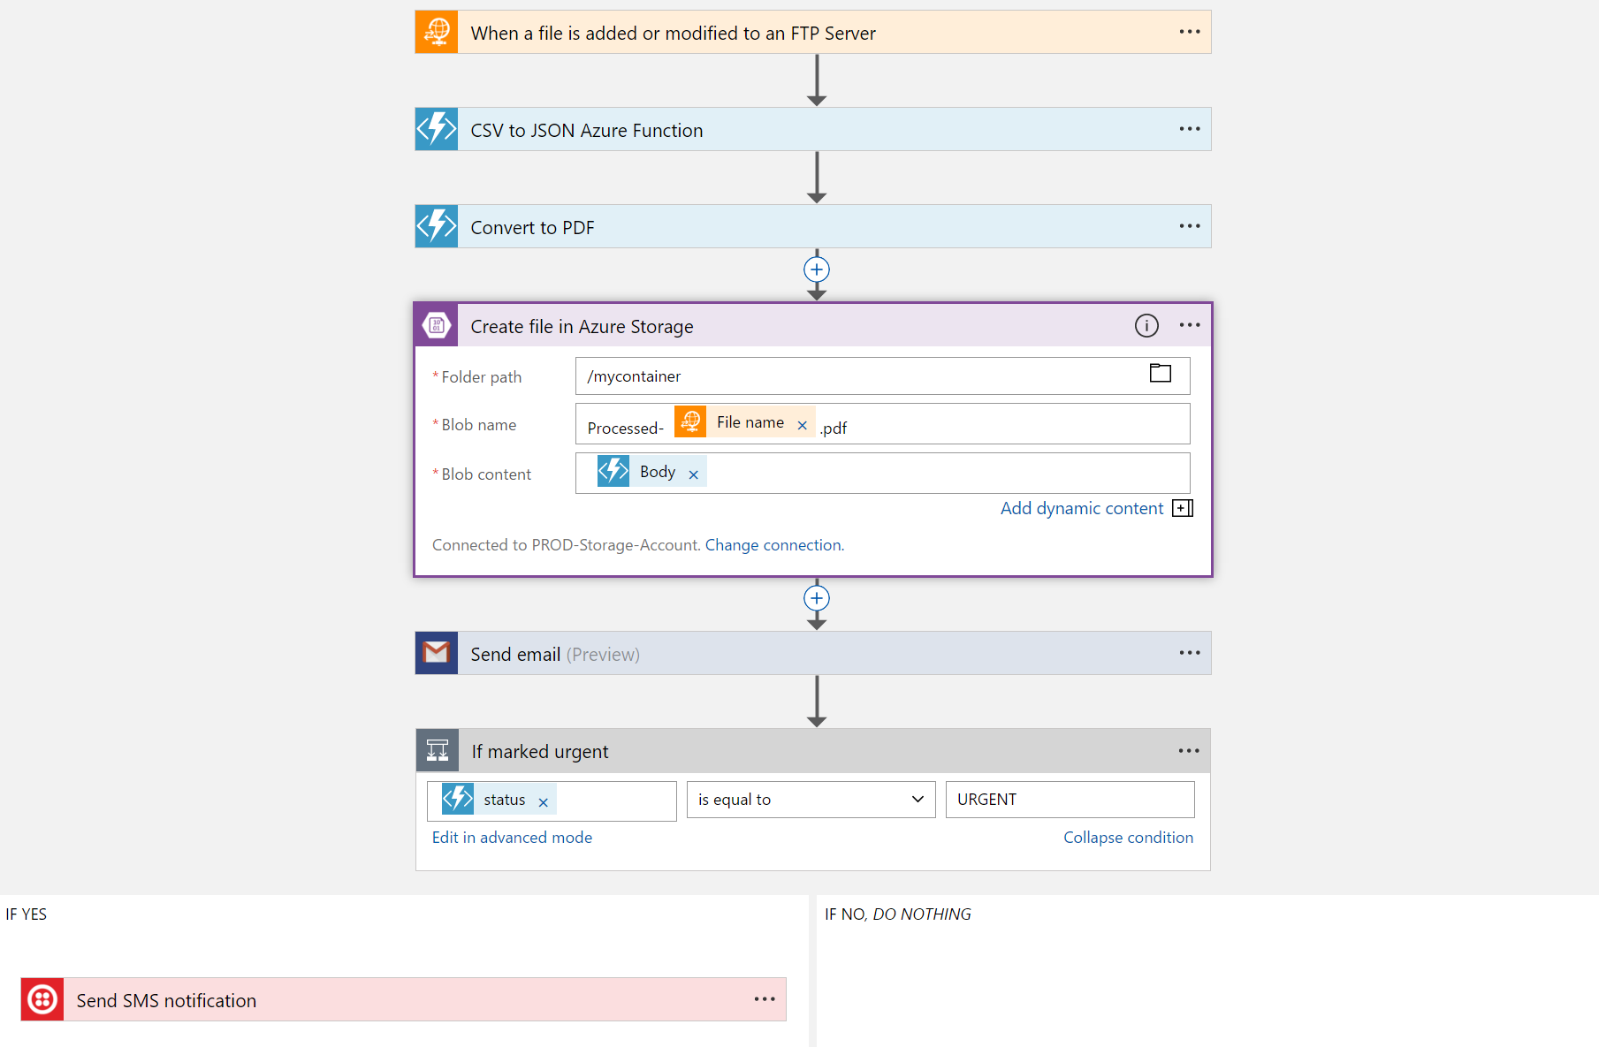
Logic Apps Workflow Designer
Serverless workflow in the cloud
Powerful control flow
Declarative definition to persist in source control and drive deployments

Slide 33
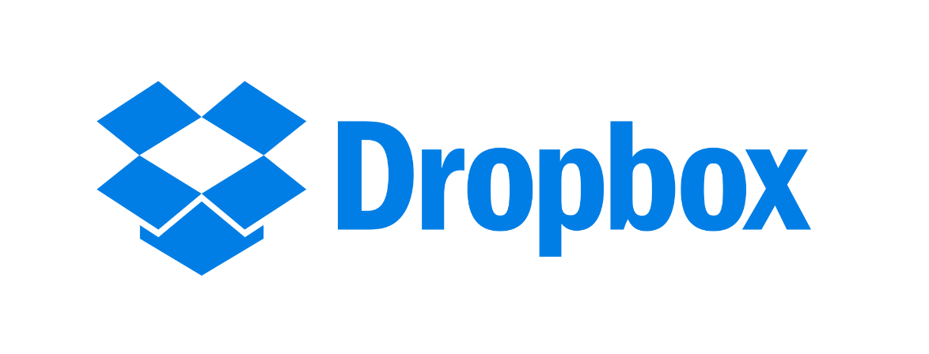








Logic apps connectors—Over 150 and growing
….and more!

Slide 34












Logic Apps Connect Everything
Azure Functions
Service bus
Cognitive services
Logic Apps
Dynamics 365
Machine learning
On-premises data gateway
BizTalk server

Slide 35
Logic Apps
SaaS
Protocols/Native
appFigures
Asana
Azure API Management
Azure App Services
Azure Automation
Azure Cognitive Face API
Azure Cognitive LUIS
Azure Cognitive Text Analytics
Azure Cognitive Vision
Azure Data Lake Store
Azure Document DB
Azure Event Hub
Azure Functions
Azure Machine Learning
Azure Resource Manager
Azure Service Bus
Azure SQL
Azure Storage Blob
Azure Storage Queues
Basecamp
Bing Search
BitBucket
Bitly
Blogger
Box
Buffer
Campfire
Chatter
Common Data Service
Disqus
DocuSign
Dropbox
Dynamics AX Online
Dynamics CRM Online
Dynamics CRM Service Bus
Dynamics Financials
Dynamics Operations
Easy Redmine
Eventbrite
Facebook
FreshBooks
Freshdesk
GitHub
Gmail
Google Calendar
Google Contacts
Google Drive
Google Sheets
Google Tasks
GoTo Meeting
GoTo Training
GoTo Webinar
Harvest
HelloSign
Infusionsoft
JIRA
Insightly
Instagram
Instapaper
MailChimp
Mandrill
Medium
Microsoft Project Online
Microsoft Translator
MSN Weather
Muhimbi PDF
Office 365
Office 365 Users
Office 365 Video
OneDrive
OneDrive for Business
OneNote
Outlook.com
Outlook Tasks
PagerDuty
Pinterest
Pipedrive
Pivotal Tracker
Power BI
Project Online
Redmine
Salesforce
Salesforce Chatter
SendGrid
SharePoint Online
Slack
SmartSheet
SparkPost
Stripe
Survey Monkey
Todoist
Toodledo
Trello
Twilio
Twitter
Typeform
UserVoice
VS Team Services
Webmerge
Wordpress
Wunderlist
Yammer
YouTube
Zendesk
HTTP, HTTPS
HTTP Webhook
FTP, SFTP
SMTP
RSS
Compose, Query, Parse JSON
Wait
Terminate
Workflow
Cloud APIs and platform functionality
Over 165 built-in connectors
Hosted and managed within the platform
Scales to meet your needs
First class designer experience
XML and EDI
XML Validation
Transform XML (+Mapper)
Flat File Encode
Flat File Decode
X12
EDIFACT
AS2
Integration Account Artifact Lookup
API connections
Authenticate once and reuse
Hybrid
BizTalk Server
File System
IBM DB2
Informix
Oracle DB
SharePoint Server
SQL Server
SAP
Websphere MQ

Slide 36
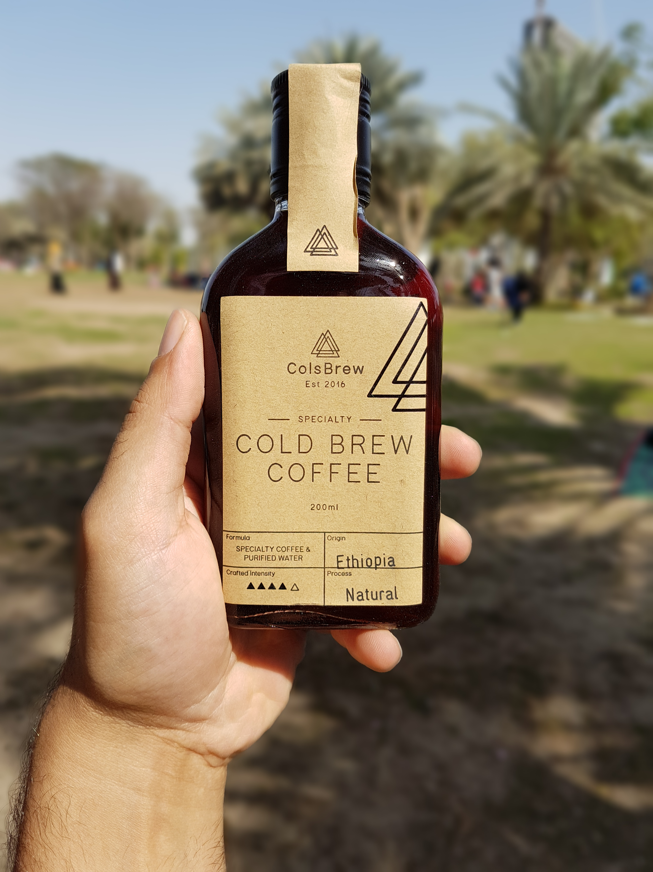
Coffee!
We start at 11:00 AM with deploying the scenario components

Slide 37
Agenda
9:00
10:30
11:00
13:30
14:30
16:30
Scenario overview
Technology overview
[Coffee Break]
Preparing and deploying the solution
Importing APIs into Azure API Management
[Lunch Break]
Connecting solution with Logic Apps
Testing the solution and final thoughts
Finish

Slide 38
Preparing and deploying the solution

Slide 39
Solution diagram
Sentiment Analysis Cognitive Services
API Management
Storage Queue
Speech Recognition Cognitive Services
Feedback Web (.NET Core) Web App on Windows
Logic App
Customer Details API (PHP) Web App on Linux
Feedback Data CosmosDB
Coupon Generator (Node.JS) Azure Function
Customer Data Azure Database for MySQL
Content Delivery Azure CDN
Blob Storage

Slide 40
0. Pre-requisites
Create Resource Group mea-app-workshop. You will deploy all resources into that group.
Create Github account.
Fork the following Github repos to your account:
http://github.com/sabbour/customerfeedback-web
http://github.com/sabbour/customerfeedback-api
http://github.com/sabbour/customerfeedback-functions

Slide 41
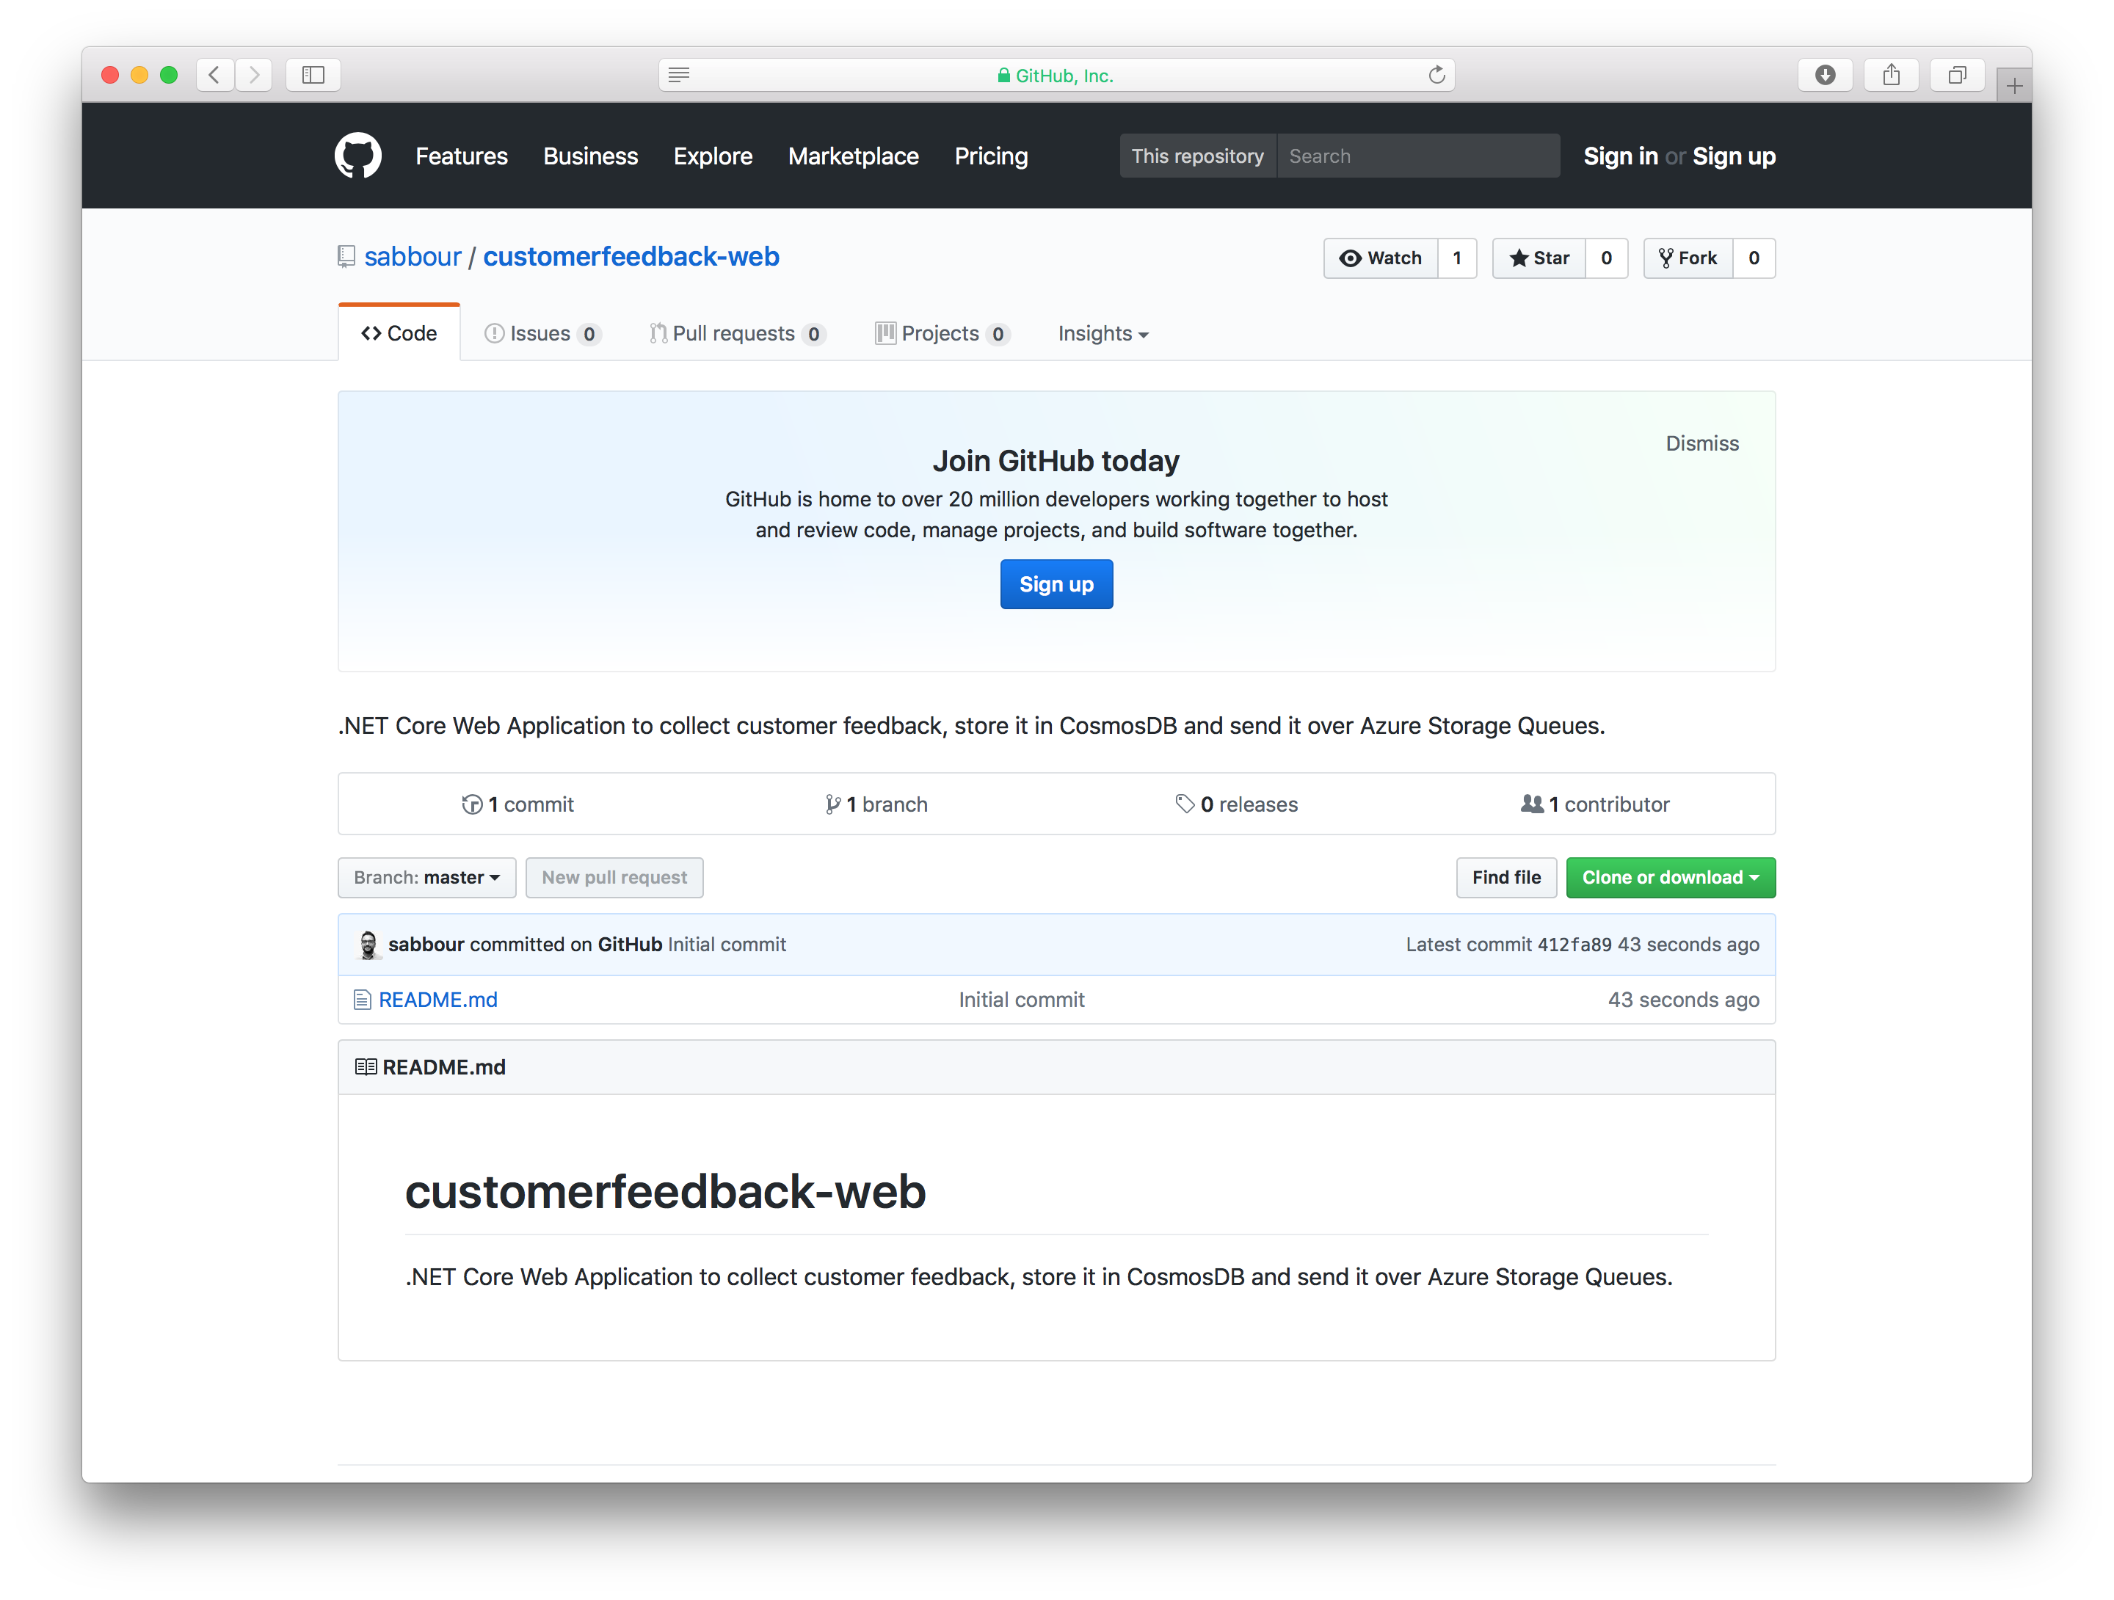

Slide 42
1. Create API Management Gateway
Give it a unique name, like [alias]apim
Choose Developer tier.
This will take about 30 minutes to provision. Proceed with the next steps.

Slide 43
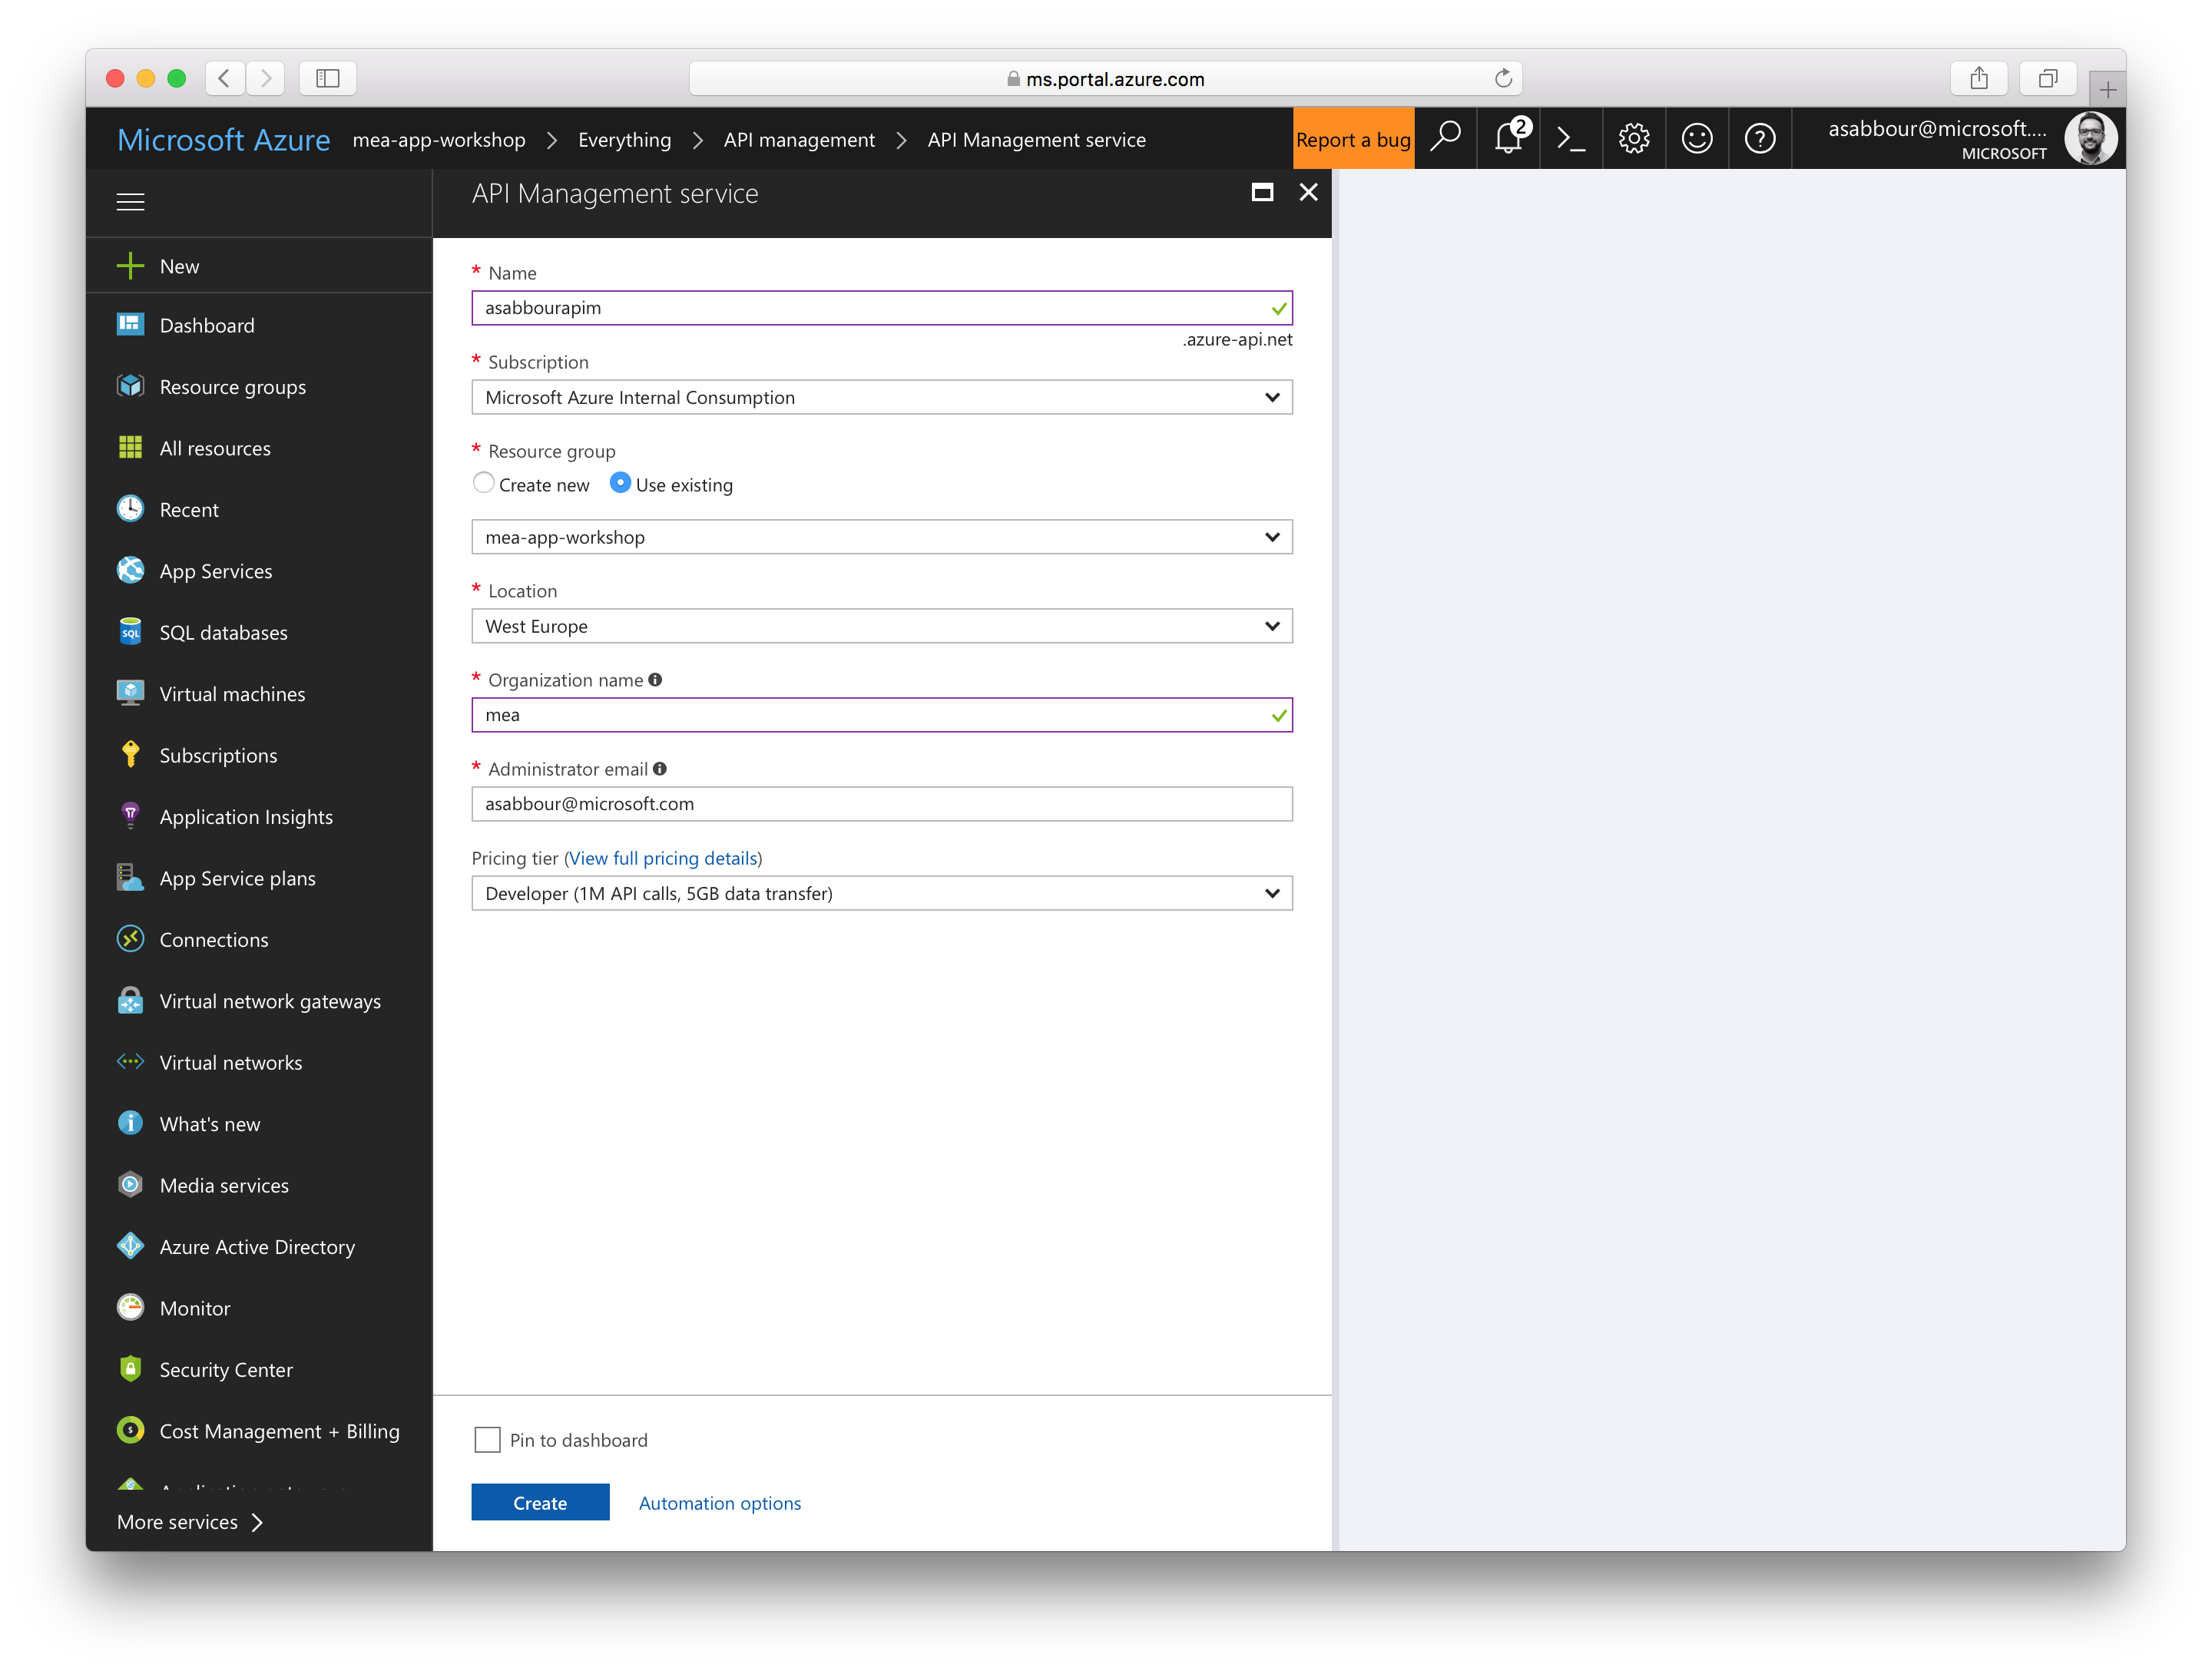

Slide 44
2. Create CosmosDB
Give it a unique name, like [alias]mongo
Choose the MongoDB API
This will take about 5 minutes to provision. Proceed with the next steps.
When the provisioning is done, go back to get the MongoDB connection string and store it aside. You’ll need it later.

Slide 45
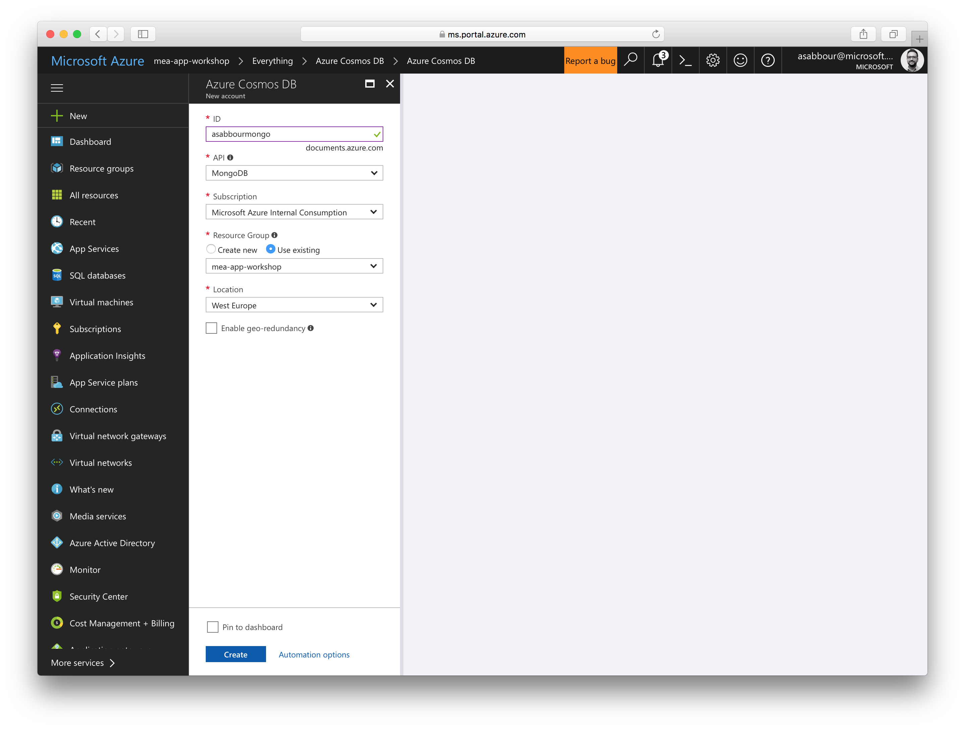

Slide 46
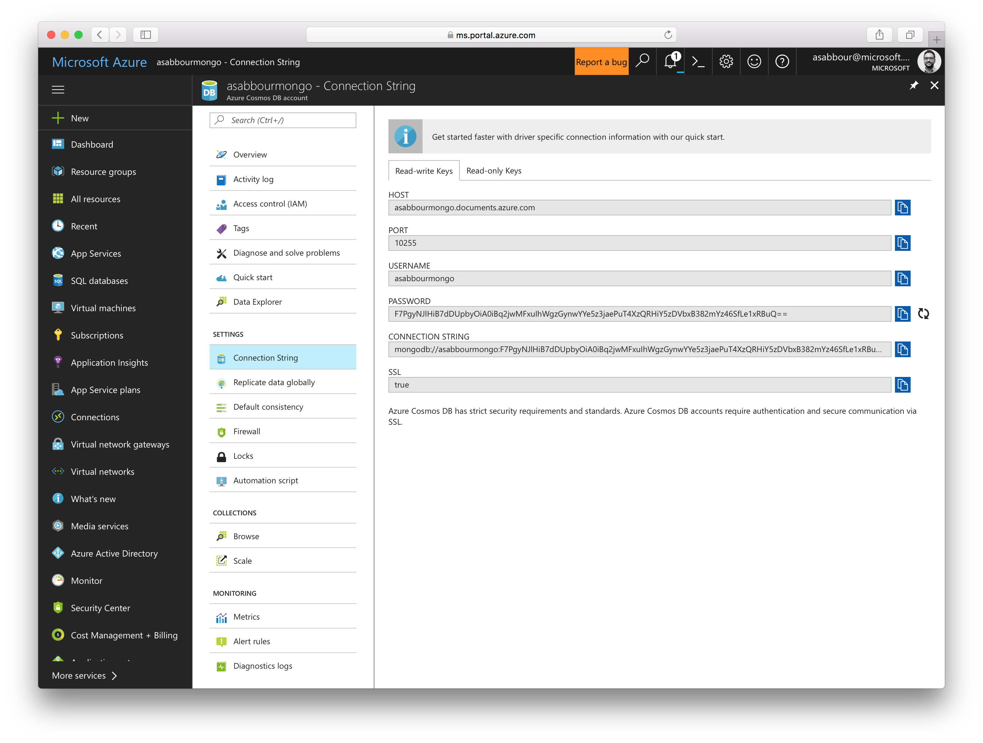

Slide 47
3. Create Bing Speech API from Cognitive Services
Give it a unique name, like [alias]speech
Choose the Free tier.
Get the key and store it aside. You’ll need it later.

Slide 48
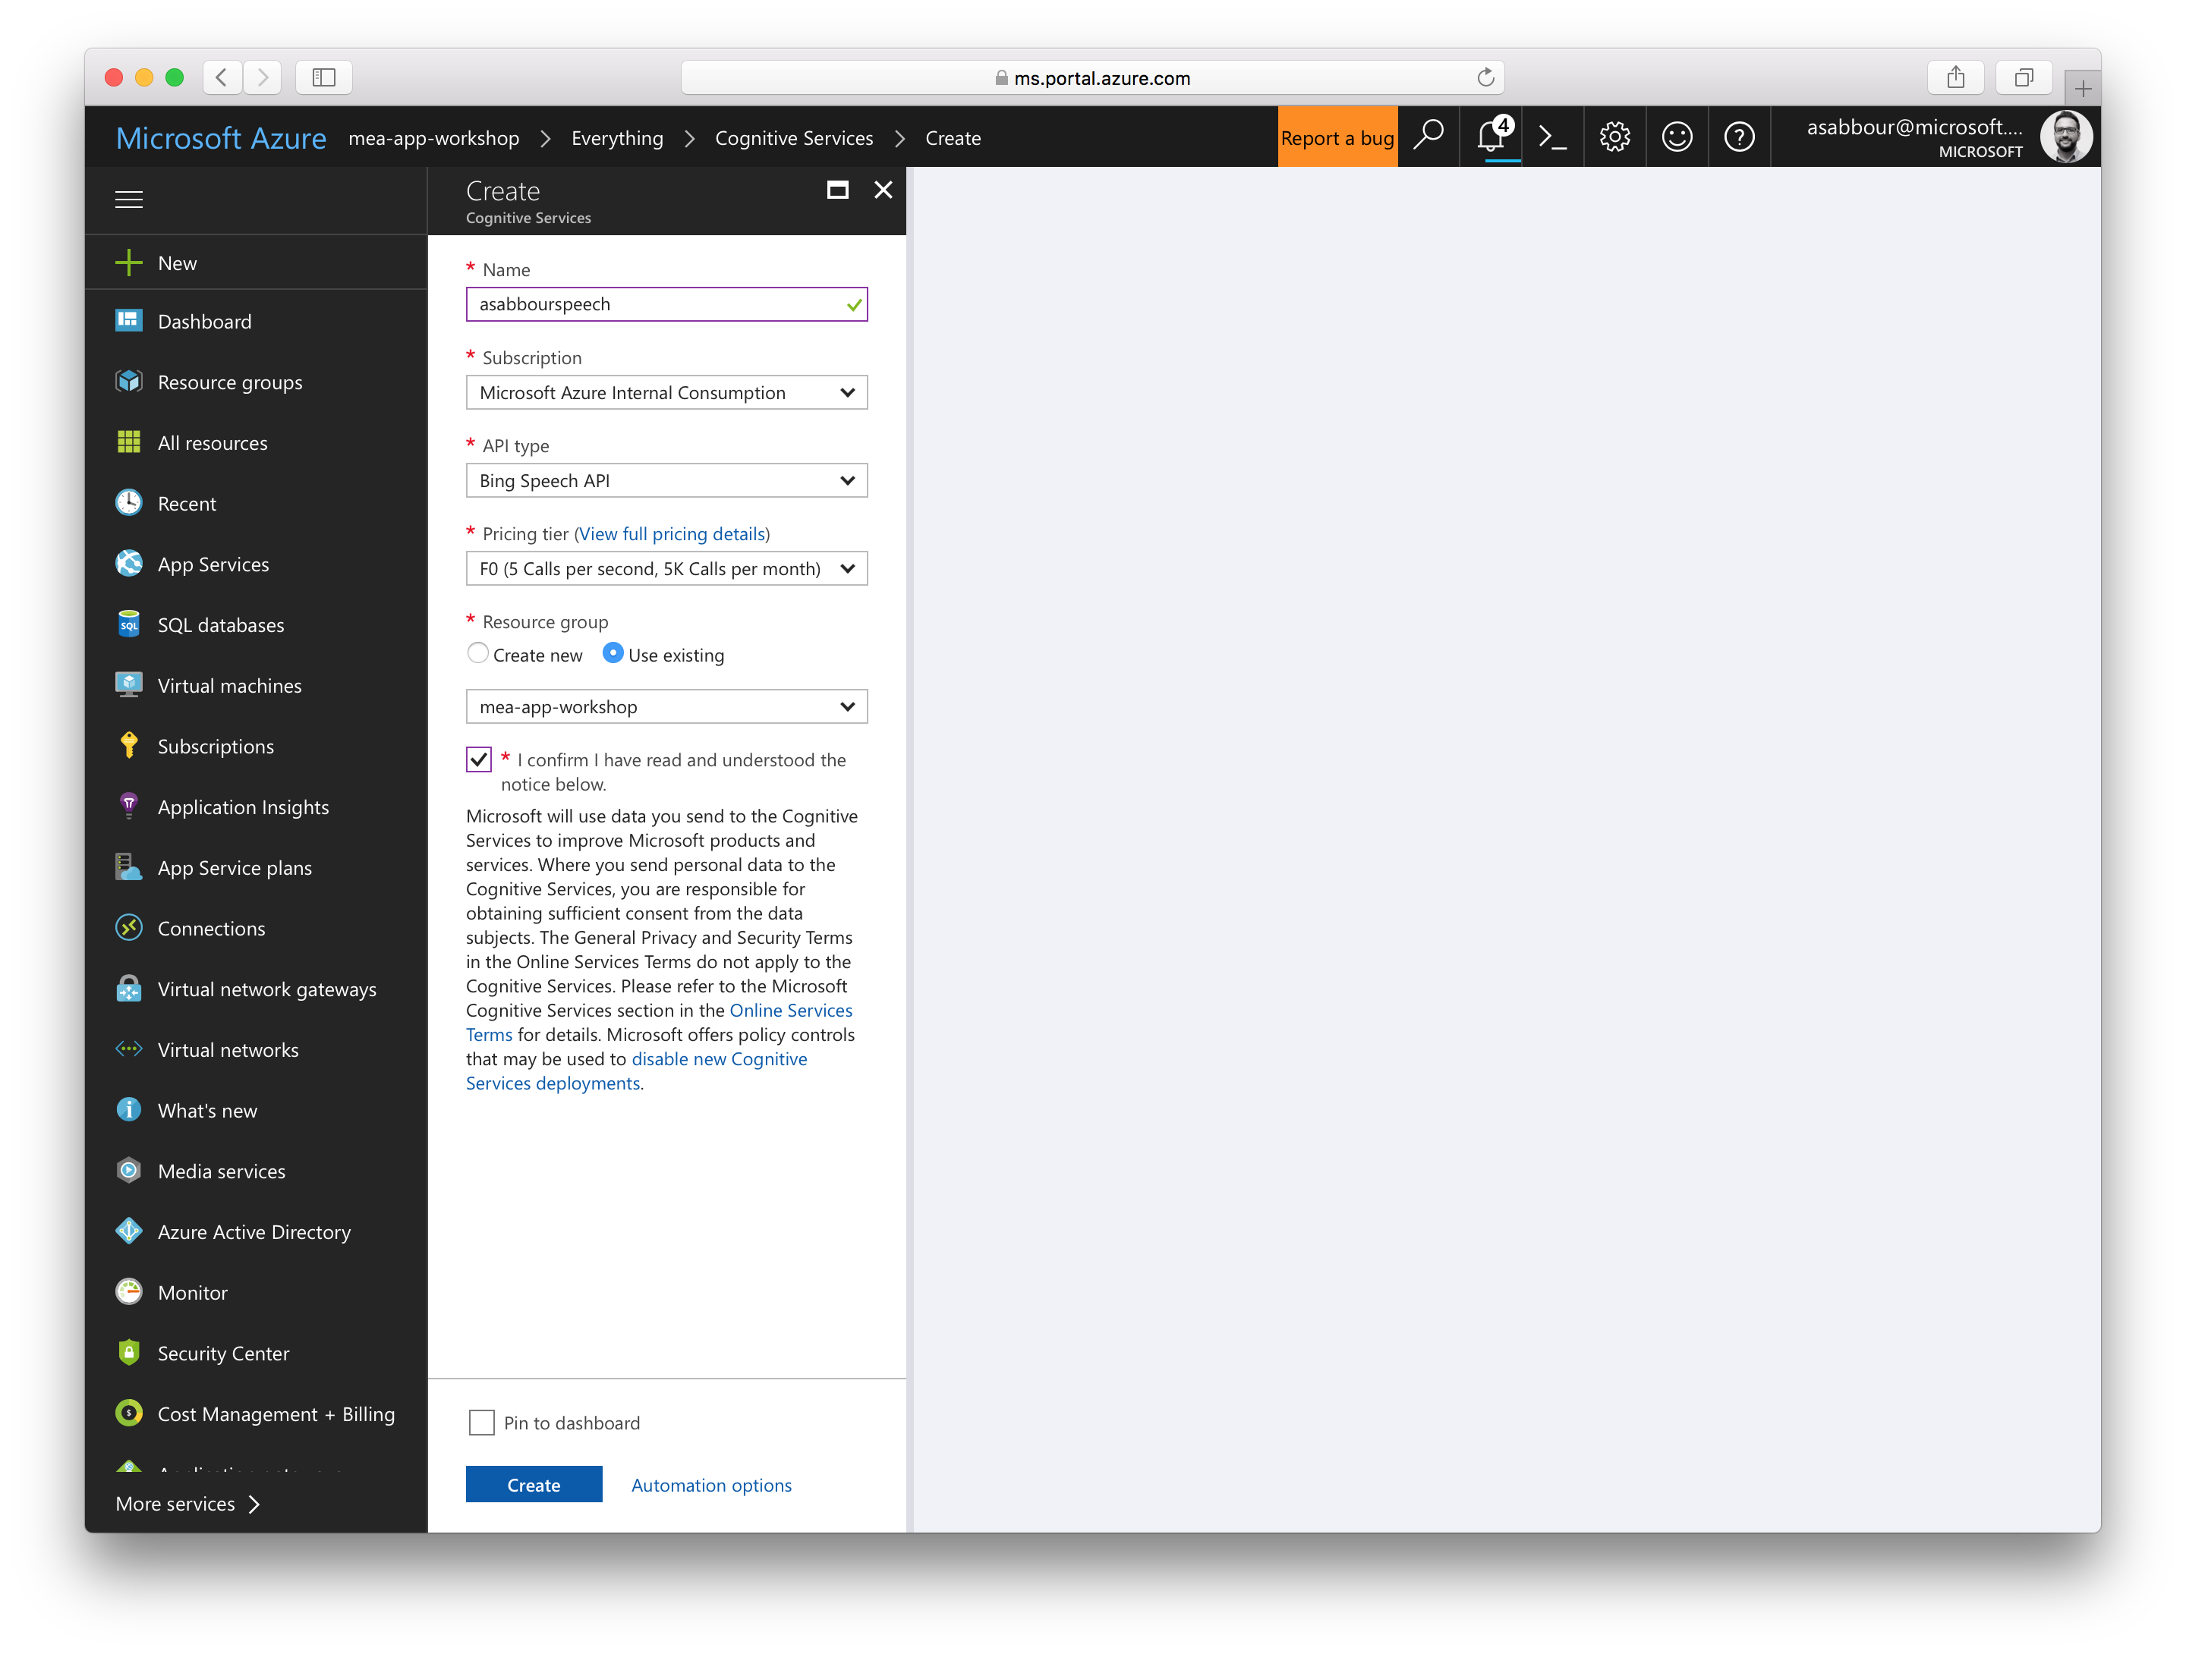

Slide 49
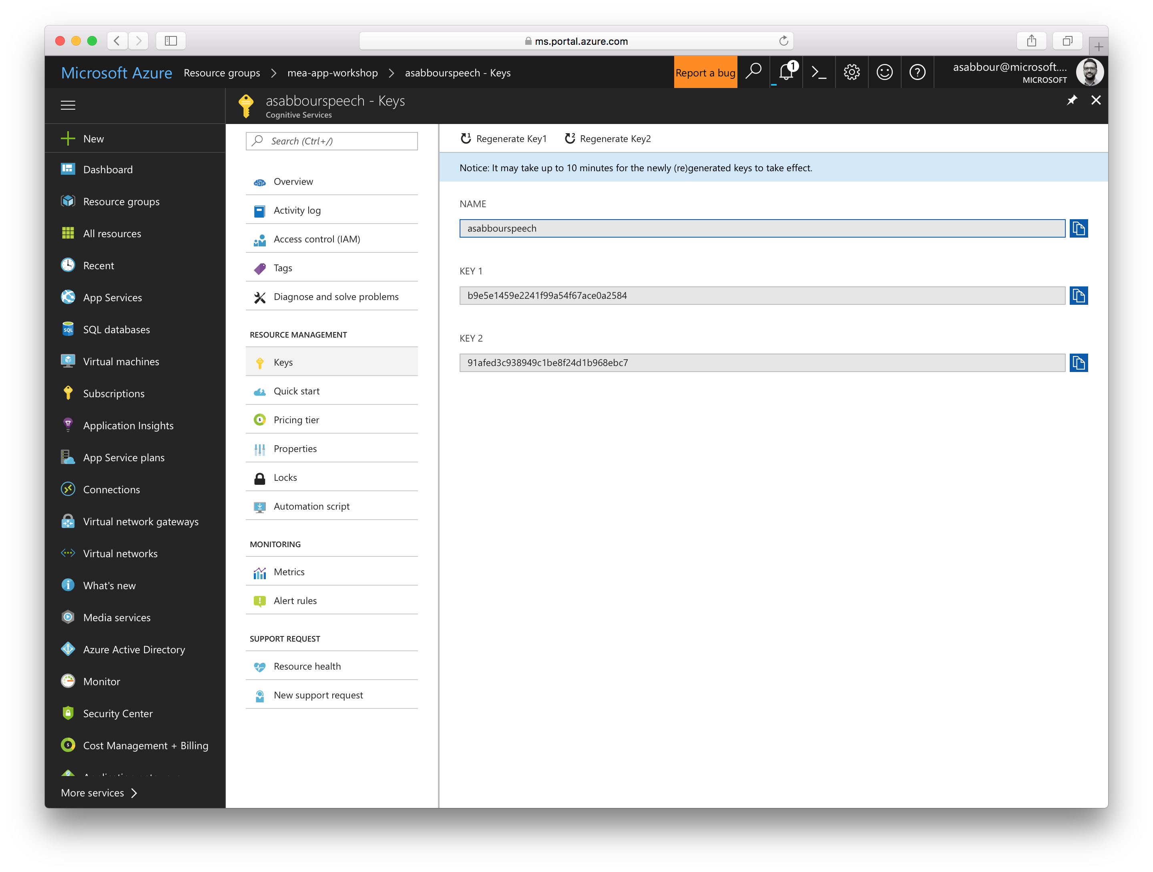

Slide 50
4. Create Text Analytics API from Cognitive Services
Give it a unique name, like [alias]text
Choose the Free tier.
Get the key and store it aside. You’ll need it later.

Slide 51
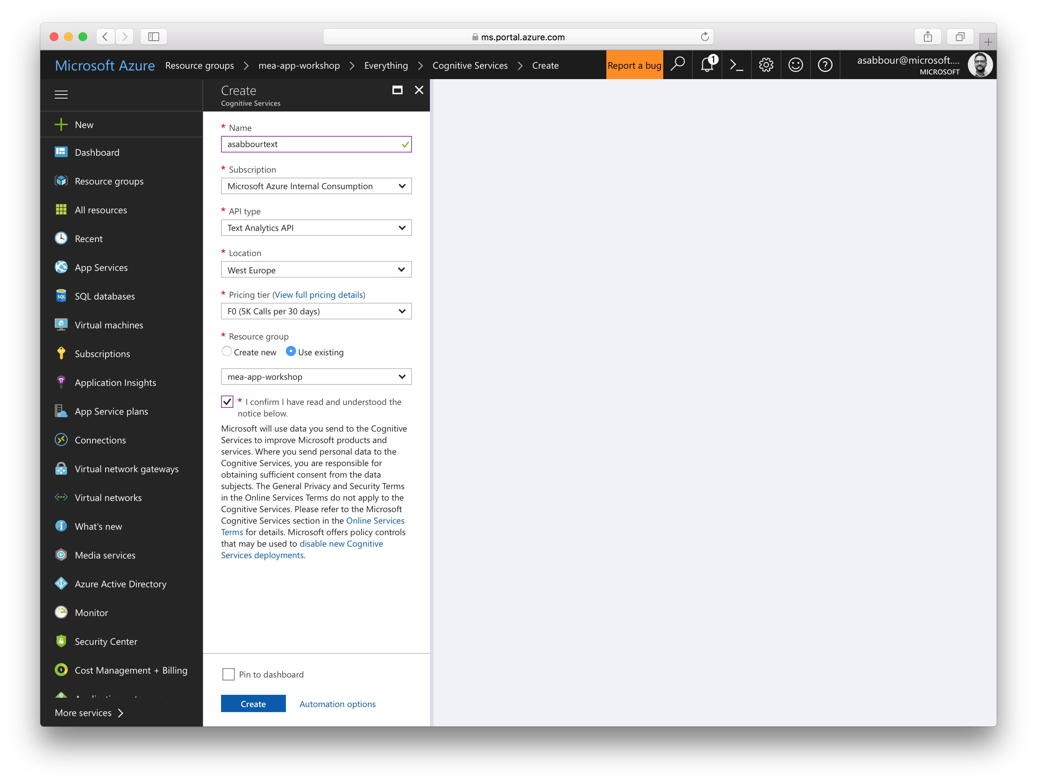

Slide 52
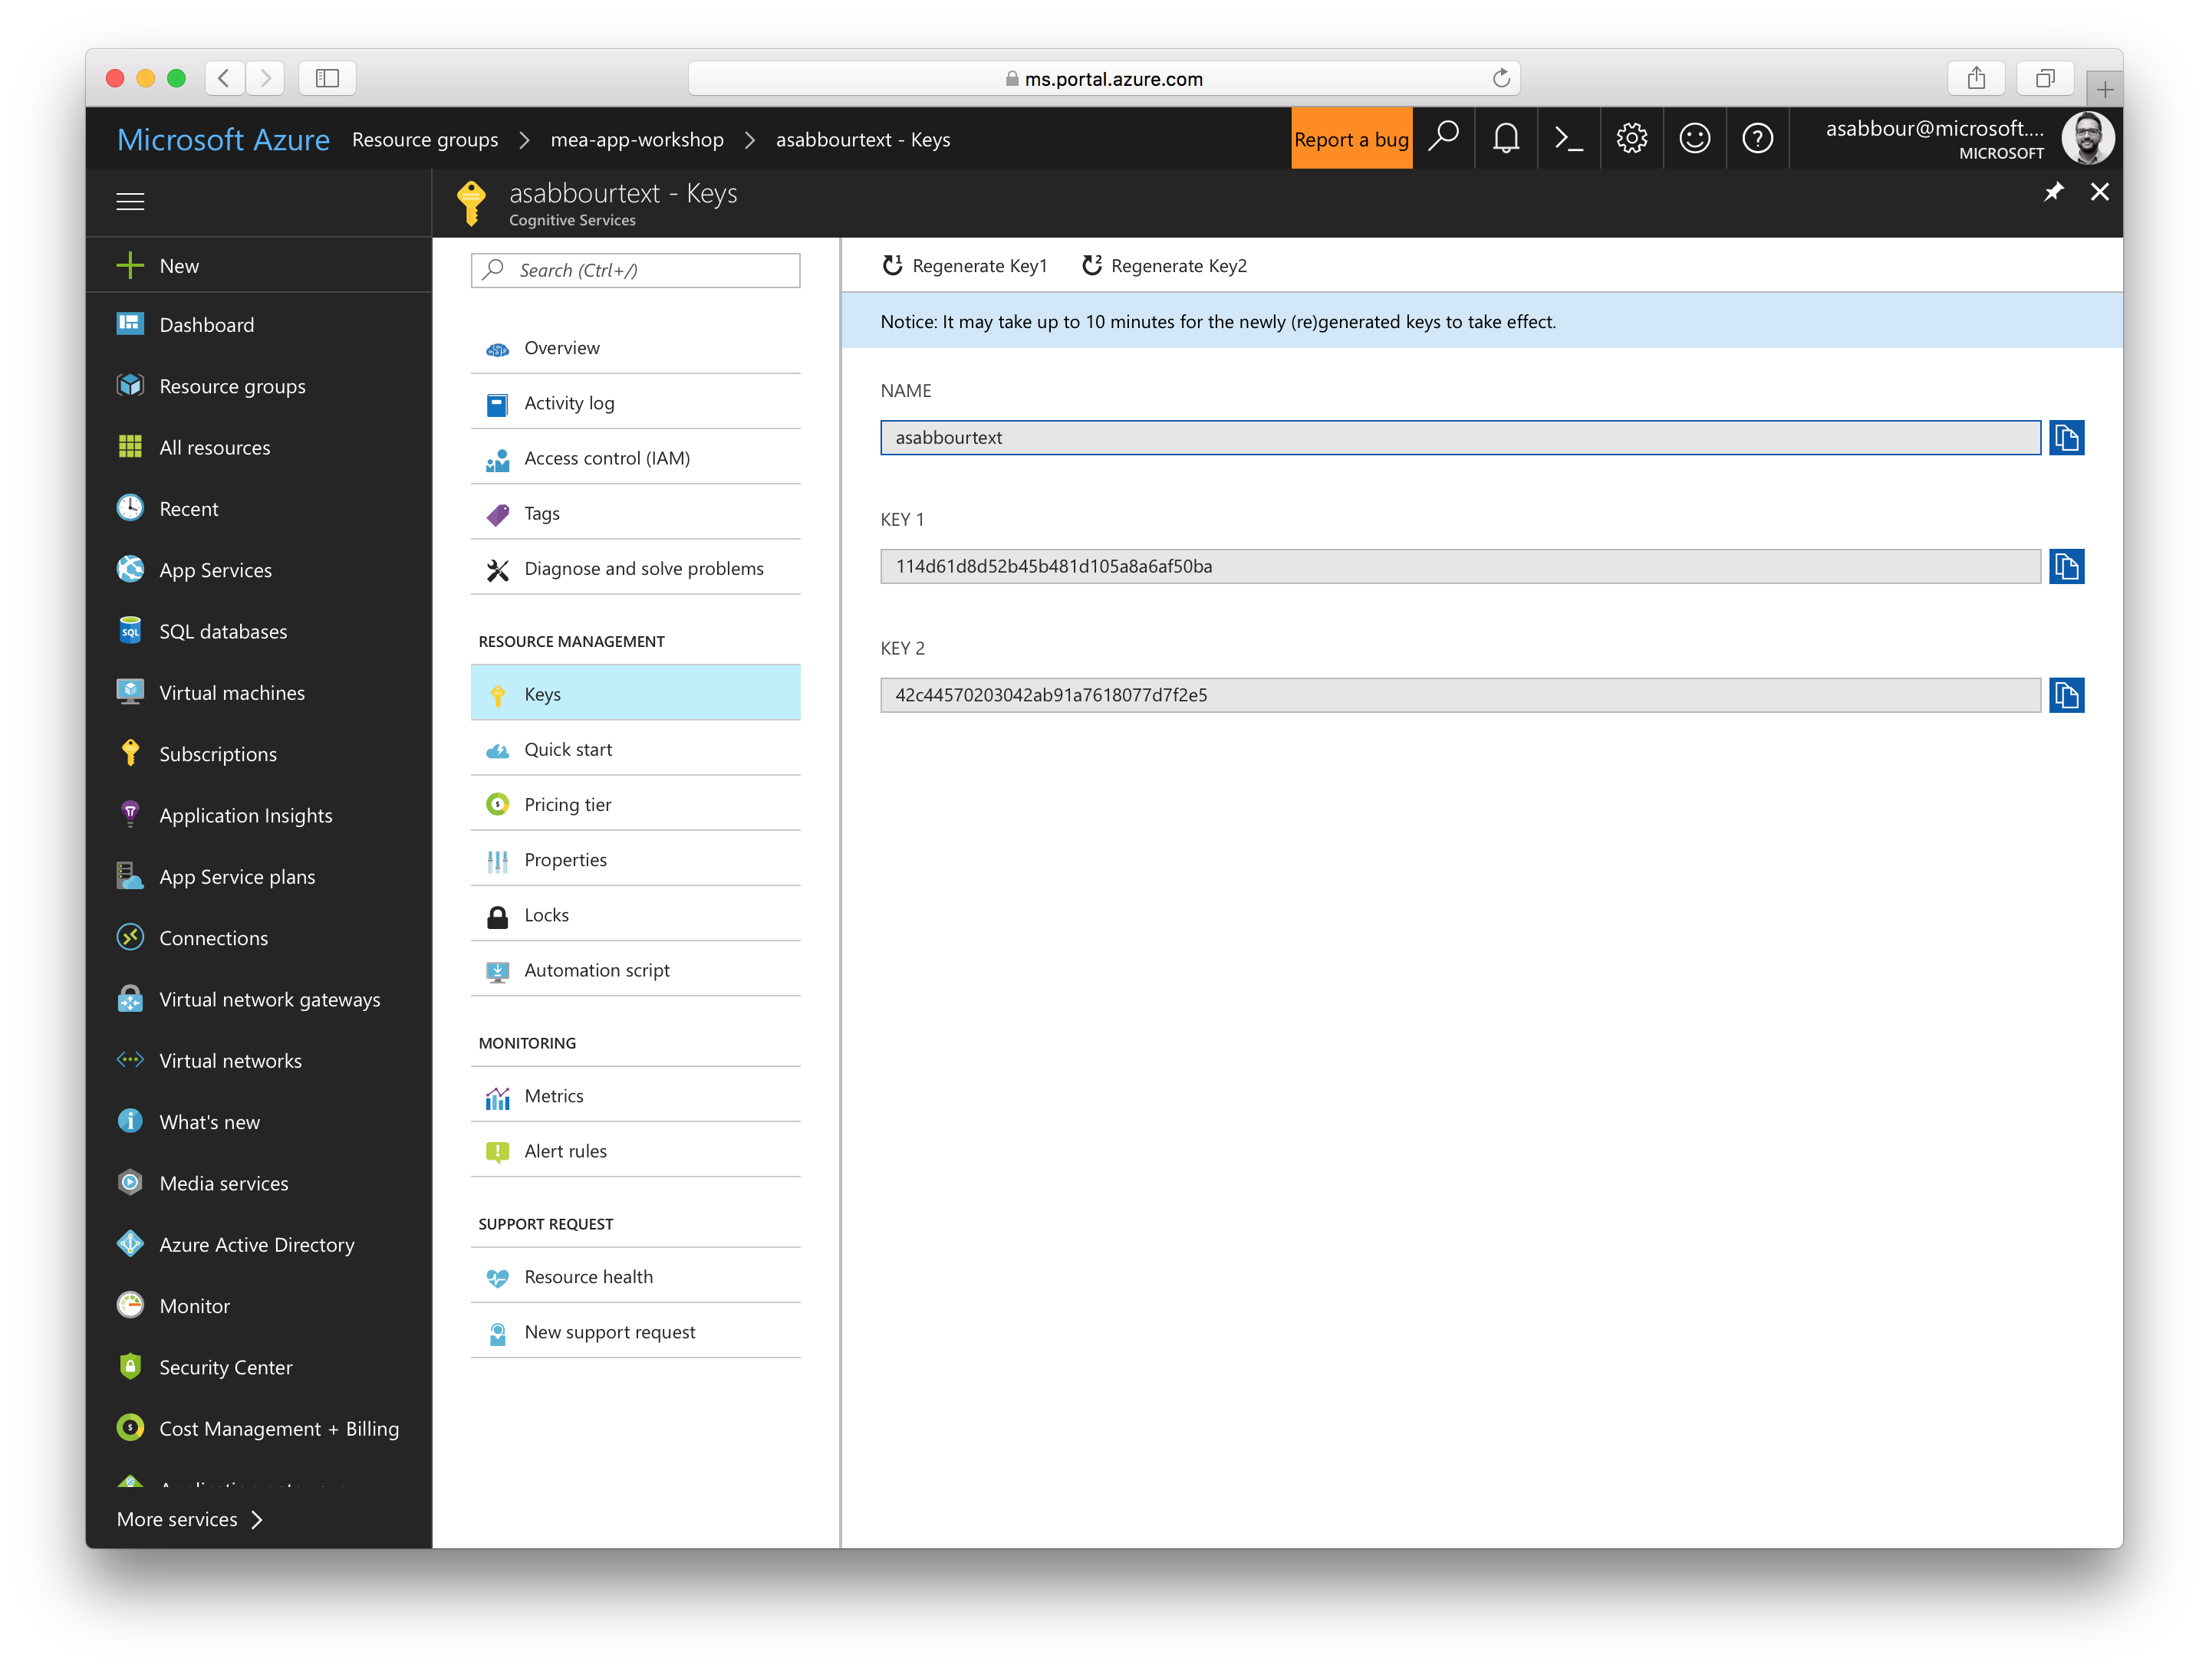

Slide 53
5. Create Azure Database for MySQL
Give it a unique name, like [alias]mysql
Provide azureuser as the admin login name.
Provide a password and write it down, as you’ll need it later.
Switch to the Basic tier and create.
Once provisioned, make note of your server name and full admin username.
Disable Enforce SSL Connection and create a firewall rule starting with 0.0.0.0 to 255.255.255.255

Slide 54


Slide 55
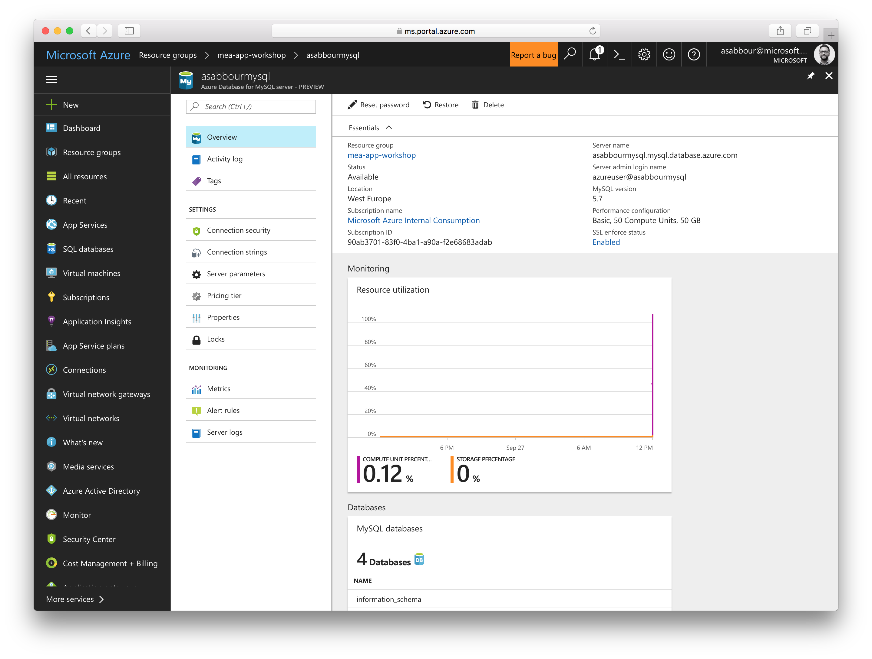

Slide 56
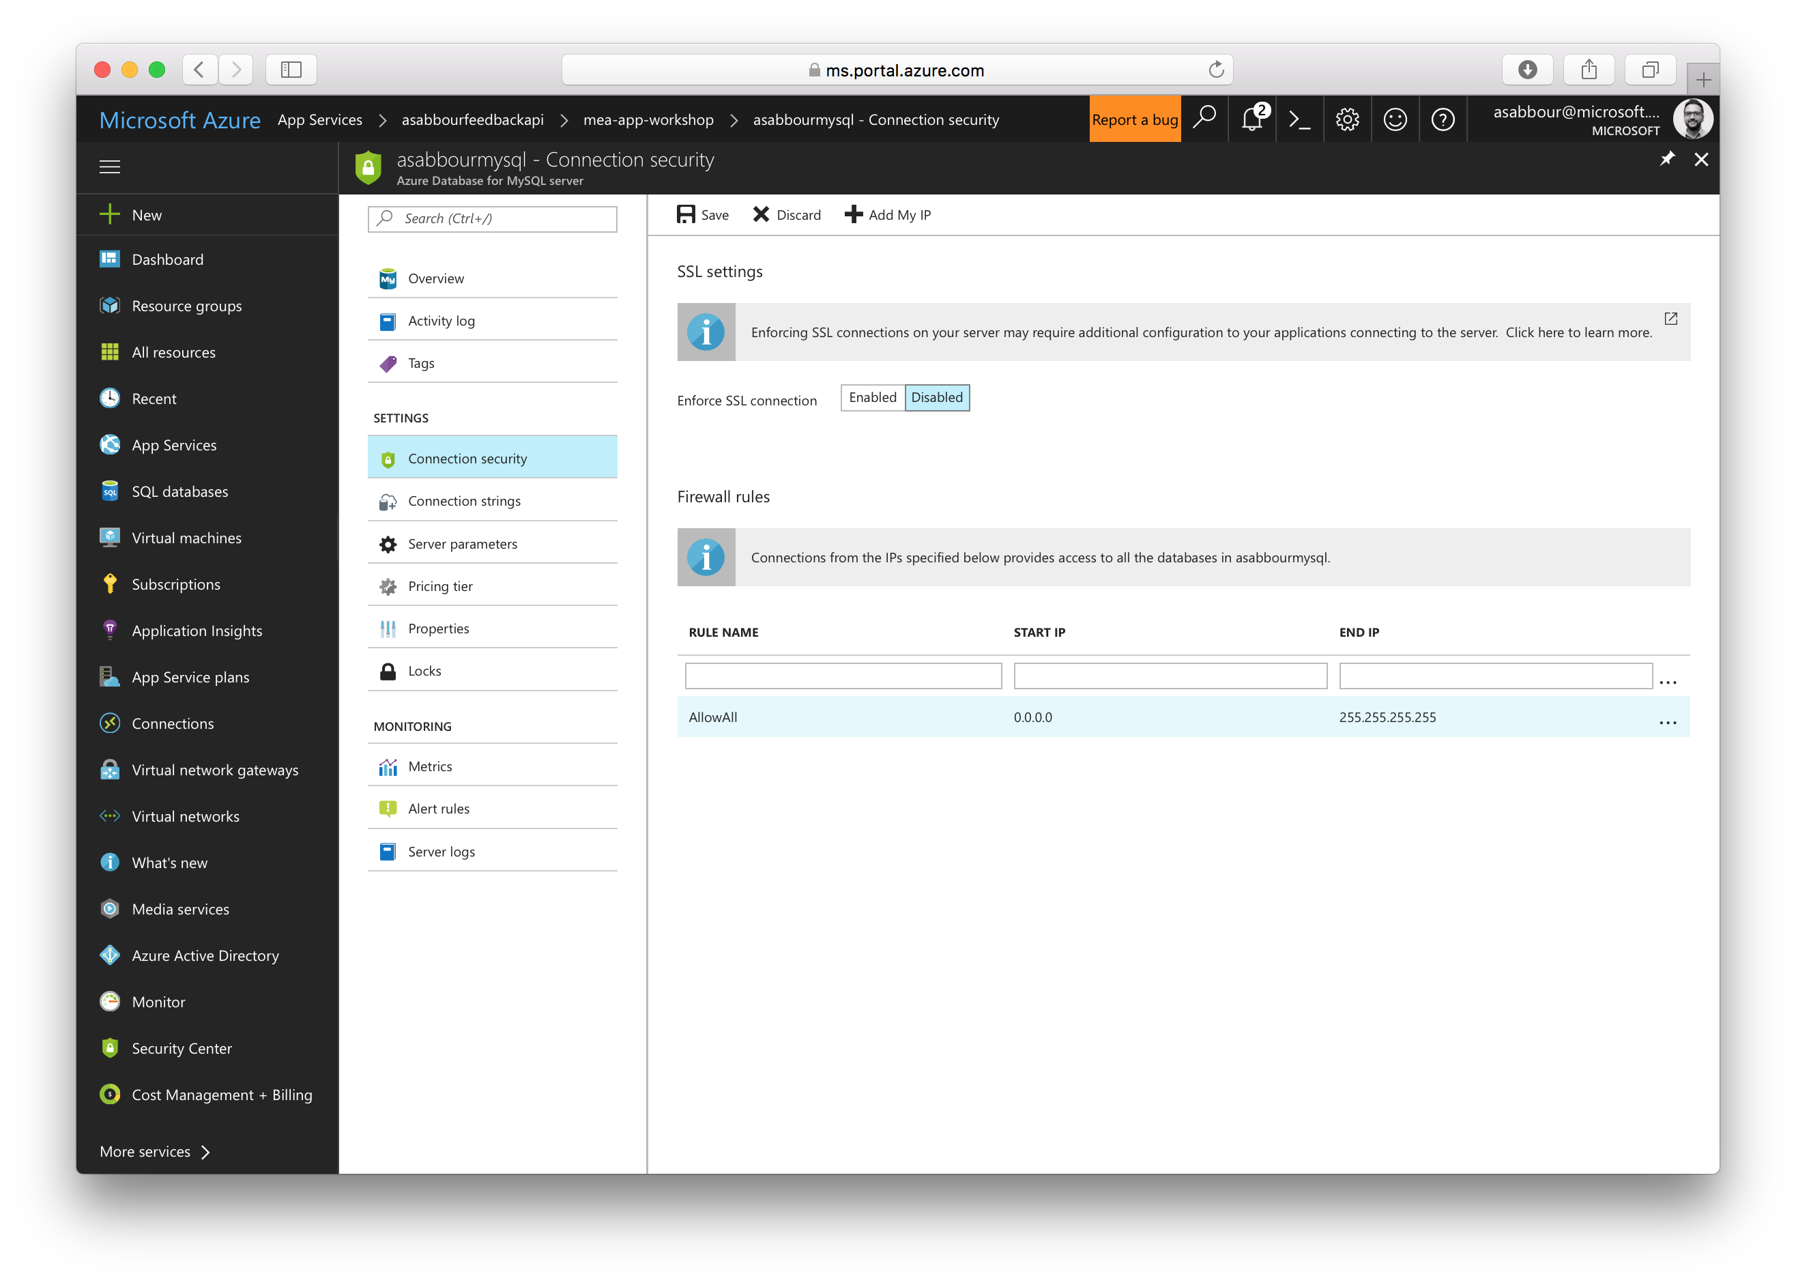

Slide 57
6. Create Storage Account
Give it a unique name, like [alias]storage
Pick General Purpose as the account kind.
Create it in the same resource group and region.
Once provisioned, make note of your storage account name and key.
Optionally, activate Azure CDN for the storage account with [alias]feedbackcdn as the CDN endpoint name and Standard Akamai as the tier.

Slide 58
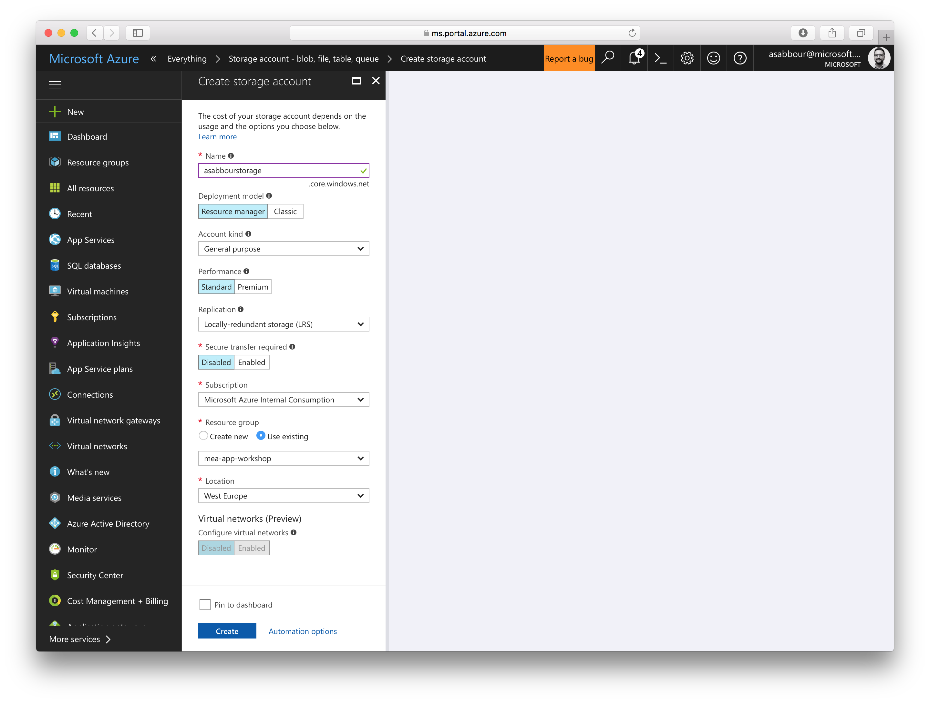

Slide 59
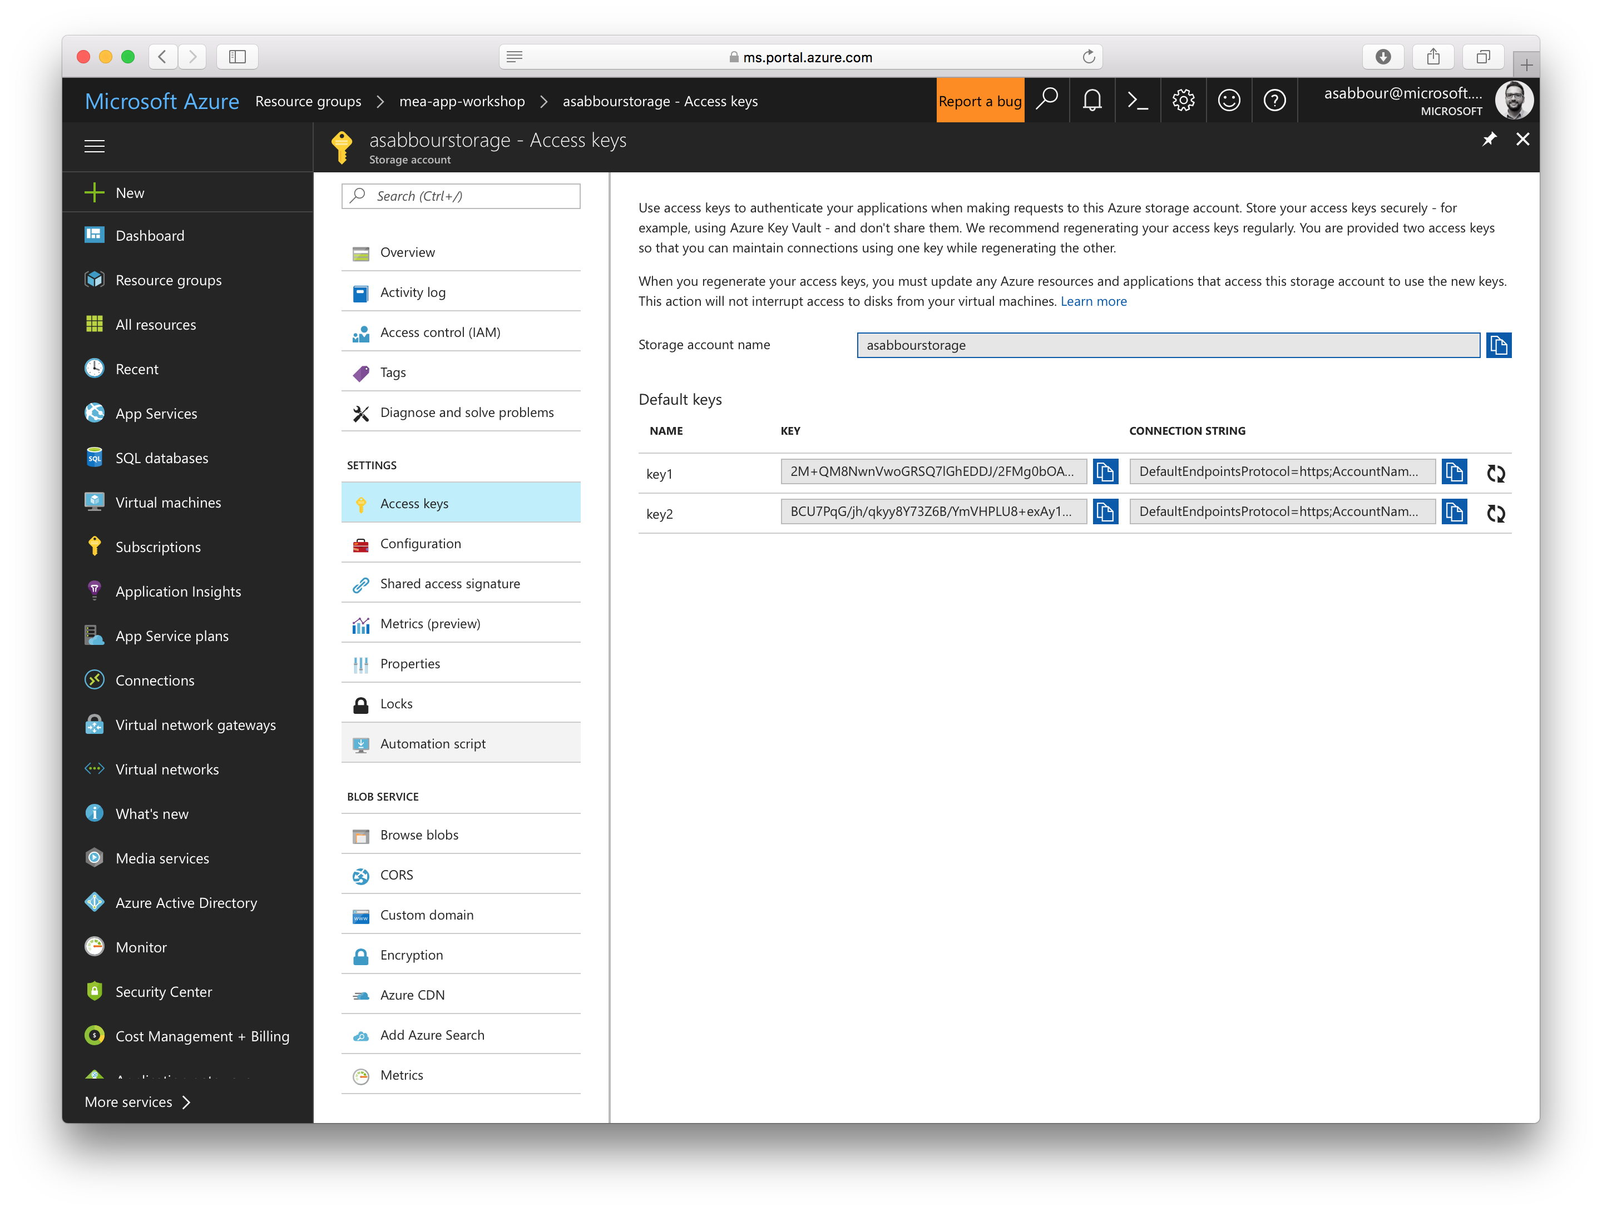

Slide 60
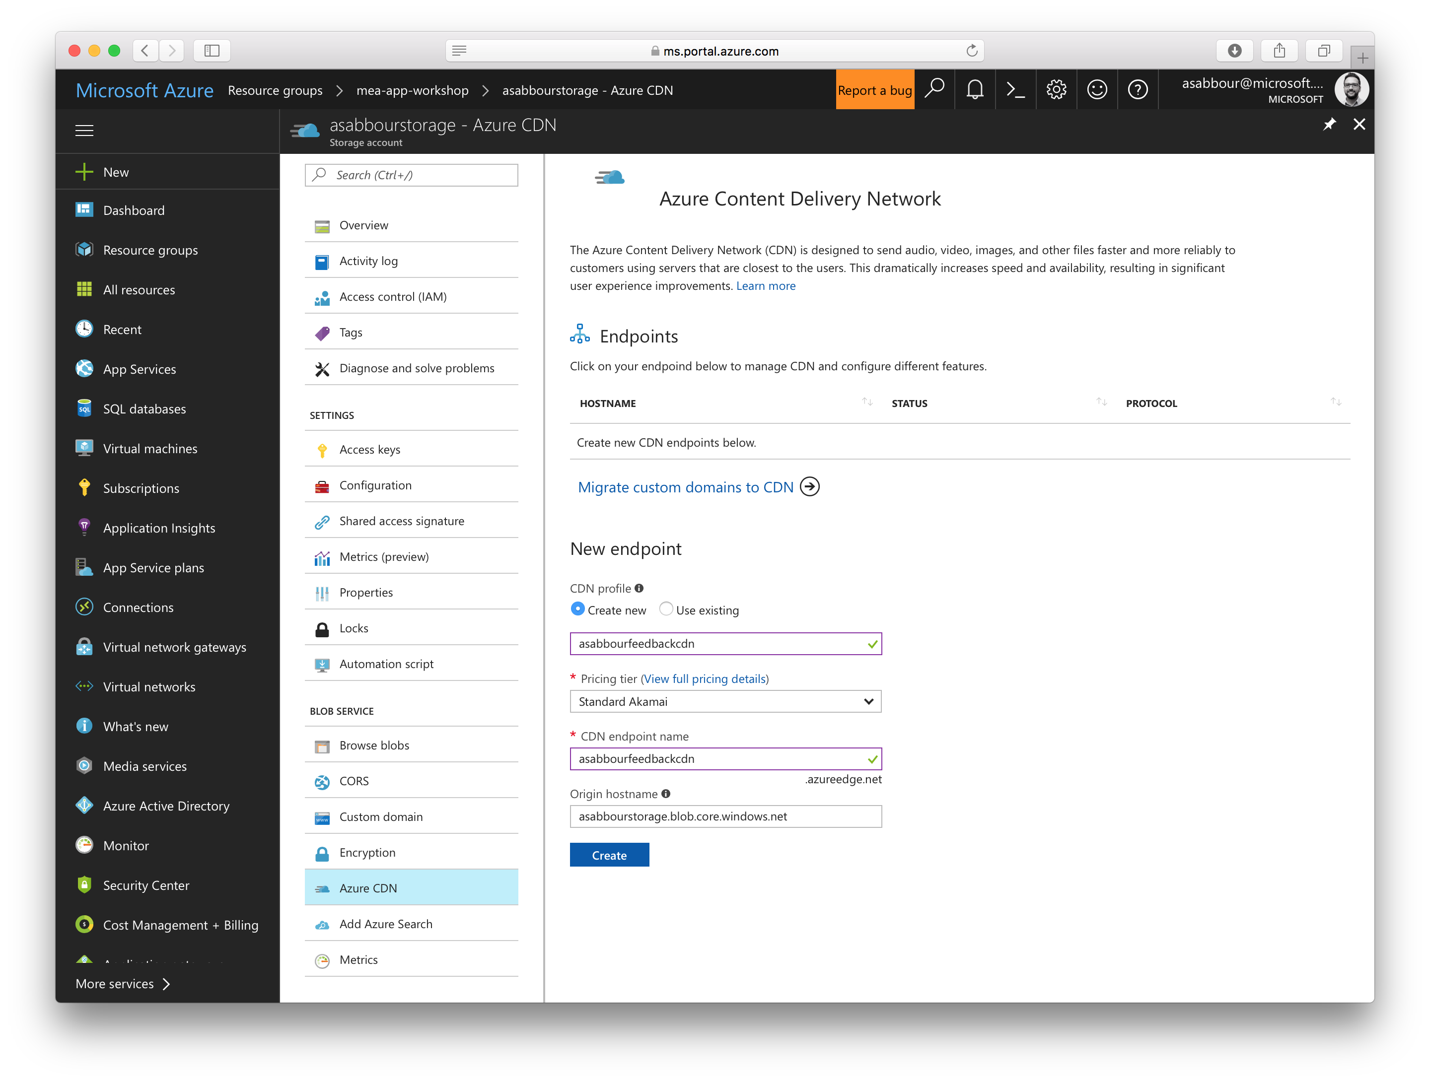

Slide 61
7.1 Create Web App for Feedback API running PHP on Linux
Give it a unique name, like [alias]feedbackapi
Choose Linux as the OS.
Choose PHP 7.0 as the Runtime Stack.

Slide 62
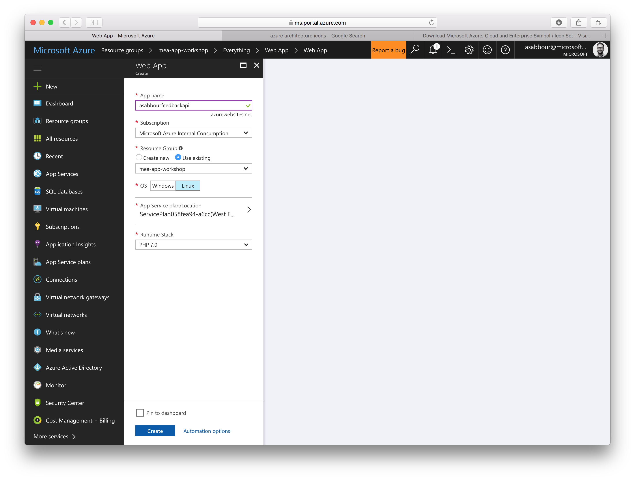

Slide 63
7.2 Configure Feedback API
Setup deployment from your customerfeedback-api Github fork.
Create App Settings with the below values:
MYSQL_SERVER: [alias]mysql.mysql.database.azure.com
MYSQL_USER: azureuser@[alias]mysql
MYSQL_PASSWORD: the password you specified earlier
Go to http://[alias]feedbackapi.azurewebsites.net/init you should see some customers already if things are configured properly.
Add your name and email

Slide 64


Slide 65
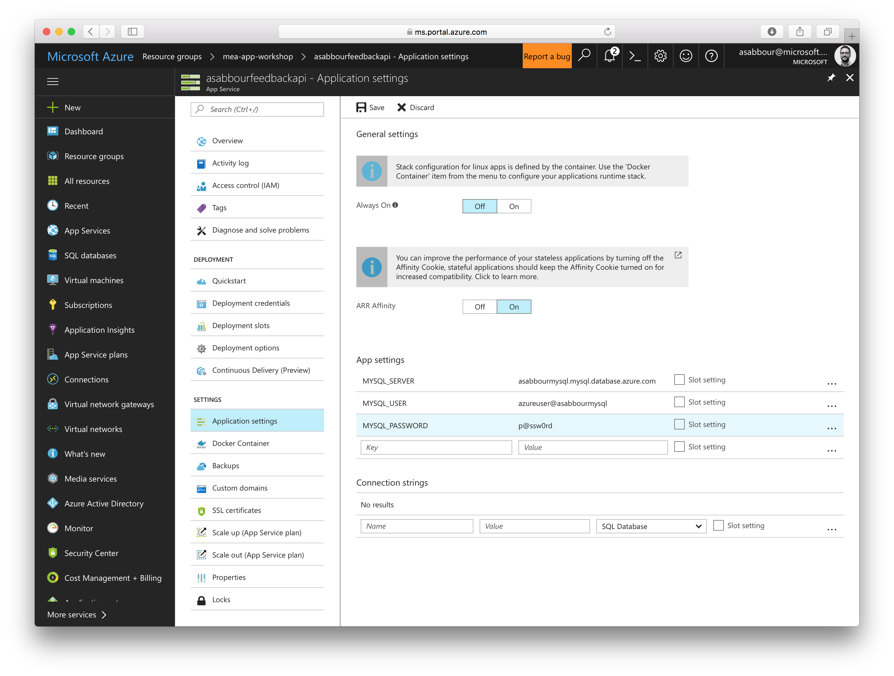

Slide 66
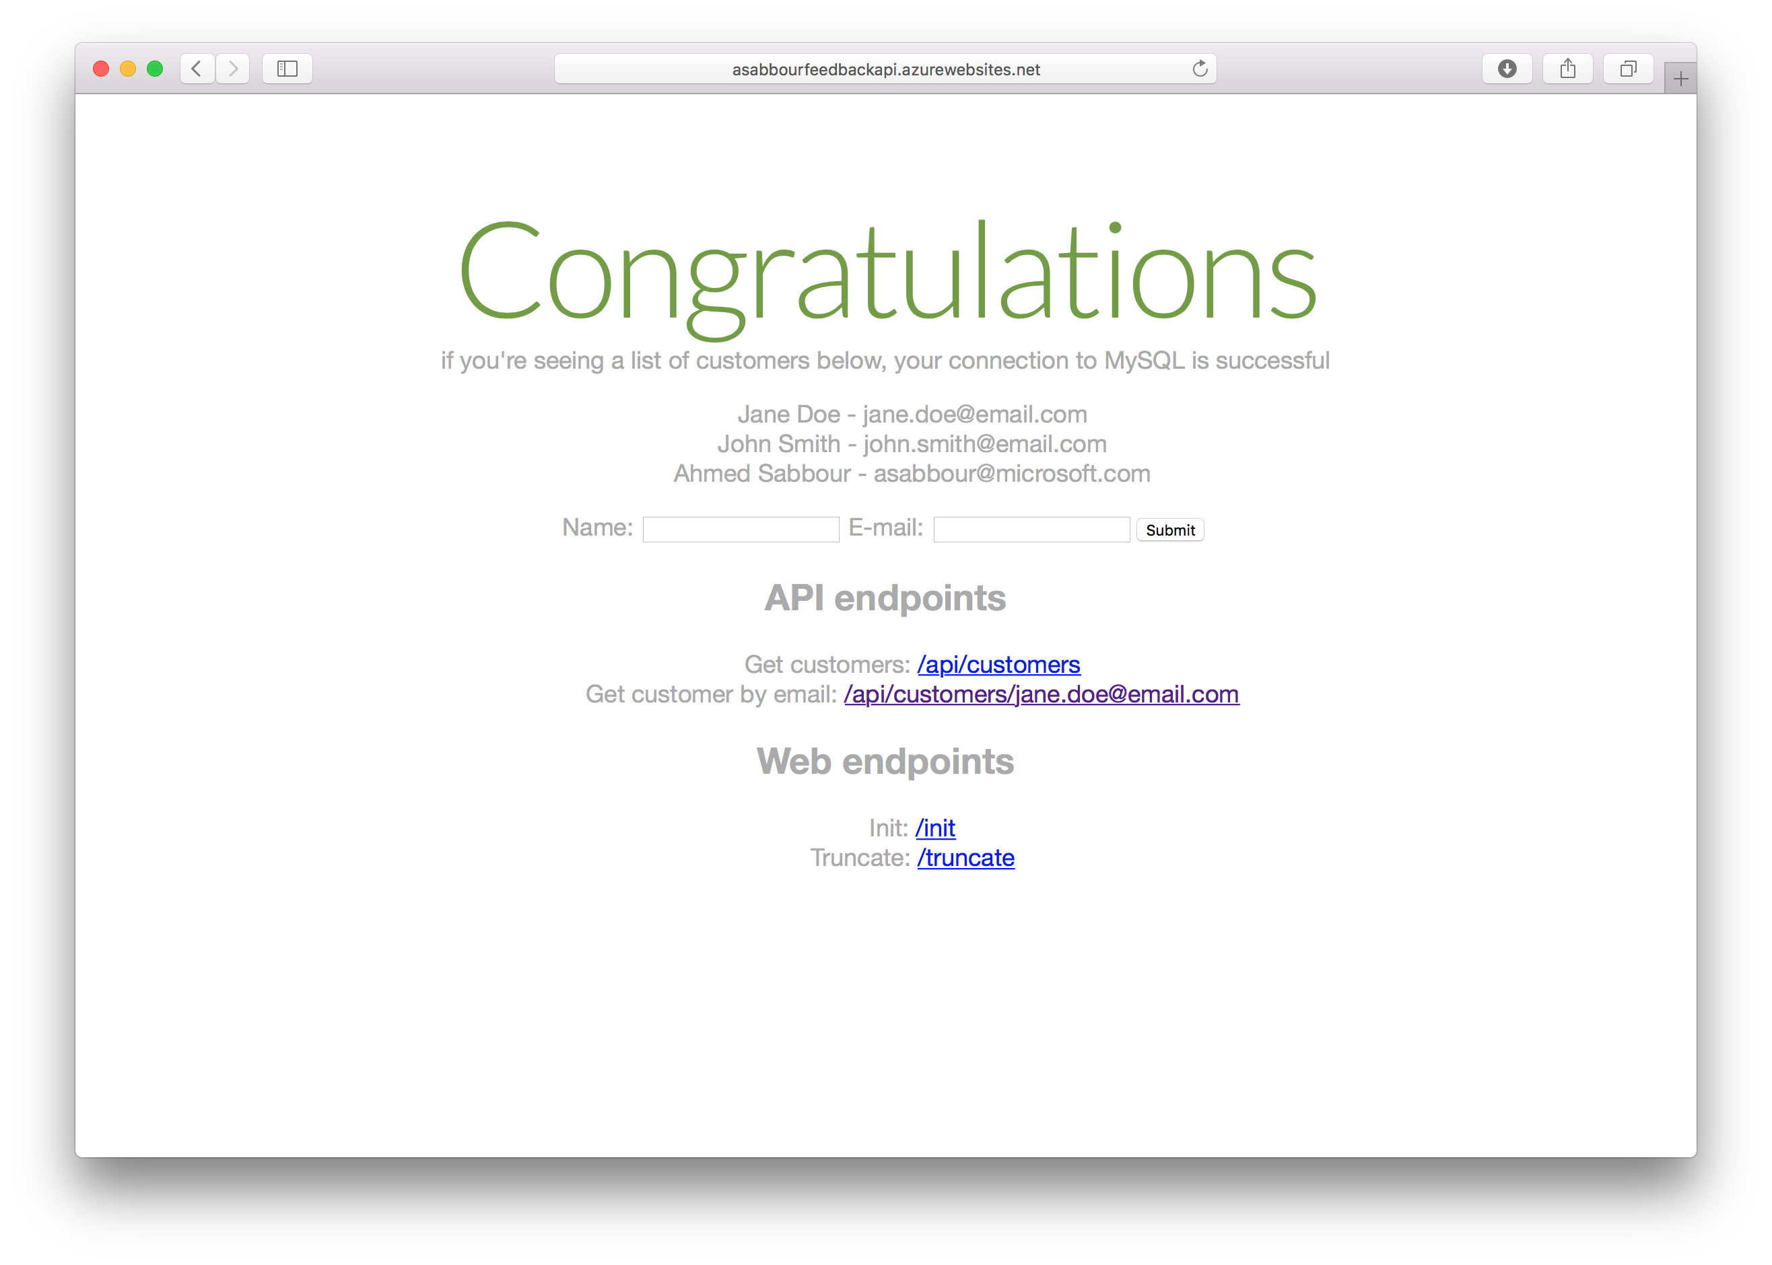

Slide 67
8.1 Create Web App for new Feedback website running .NET on Windows
Give it a unique name, like [alias]feedbackweb
Choose Windows as the OS.

Slide 68


Slide 69
8.2 Configure the new .NET Feedback website
Setup deployment from your customerfeedback-web Github fork.
Create App Settings with the below values:
MONGO_URL: mongodb connection string specified earlier
SPEECH_KEY: speech API key specified earlier
STORAGEACCOUNT_NAME: storage account name
STORAGEACCOUNT_KEY: storage account key
Go to http://[alias]feedbackweb.azurewebsites.net you should see a form to collect feedback

Slide 70


Slide 71
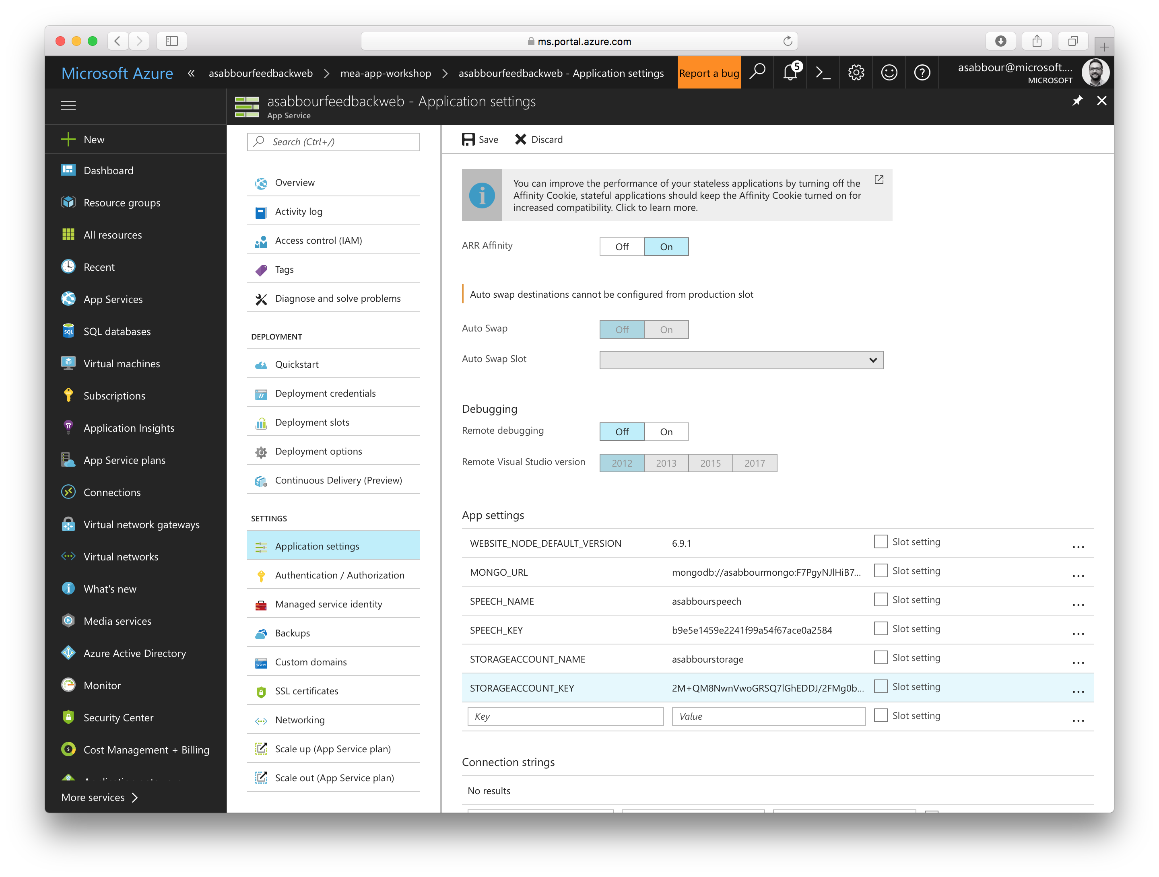

Slide 72
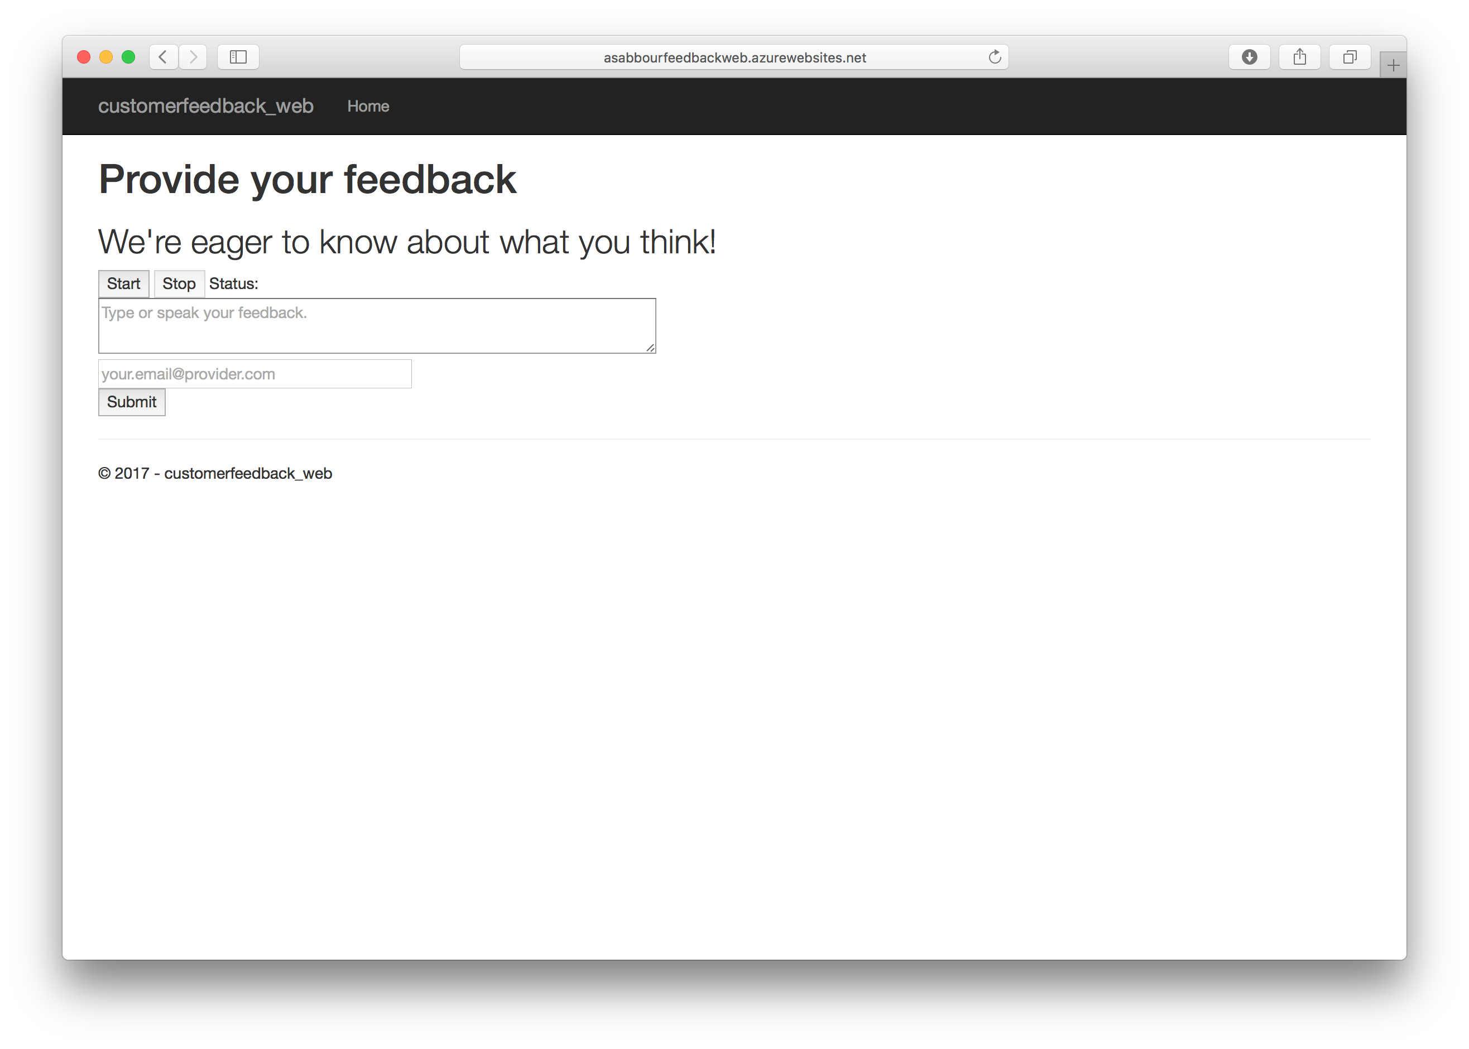

Slide 73
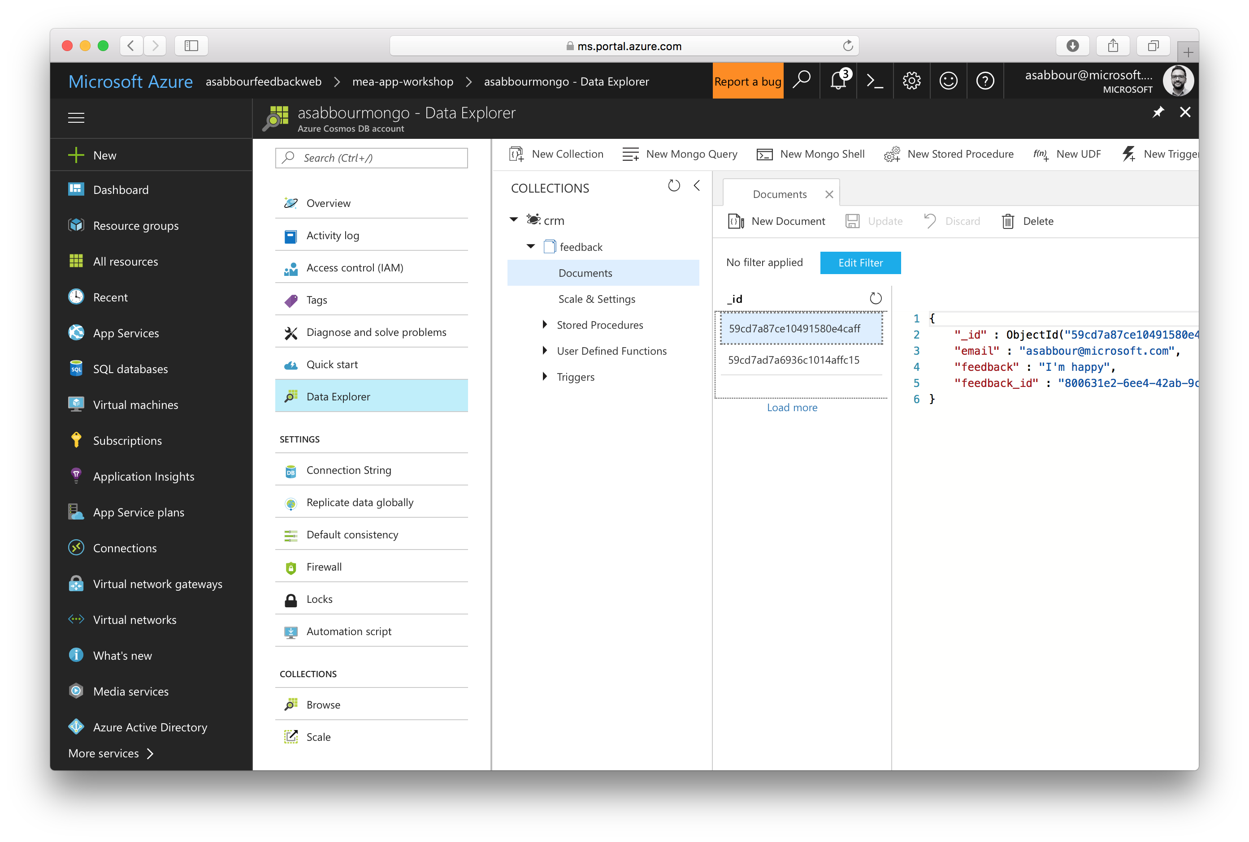

Slide 74
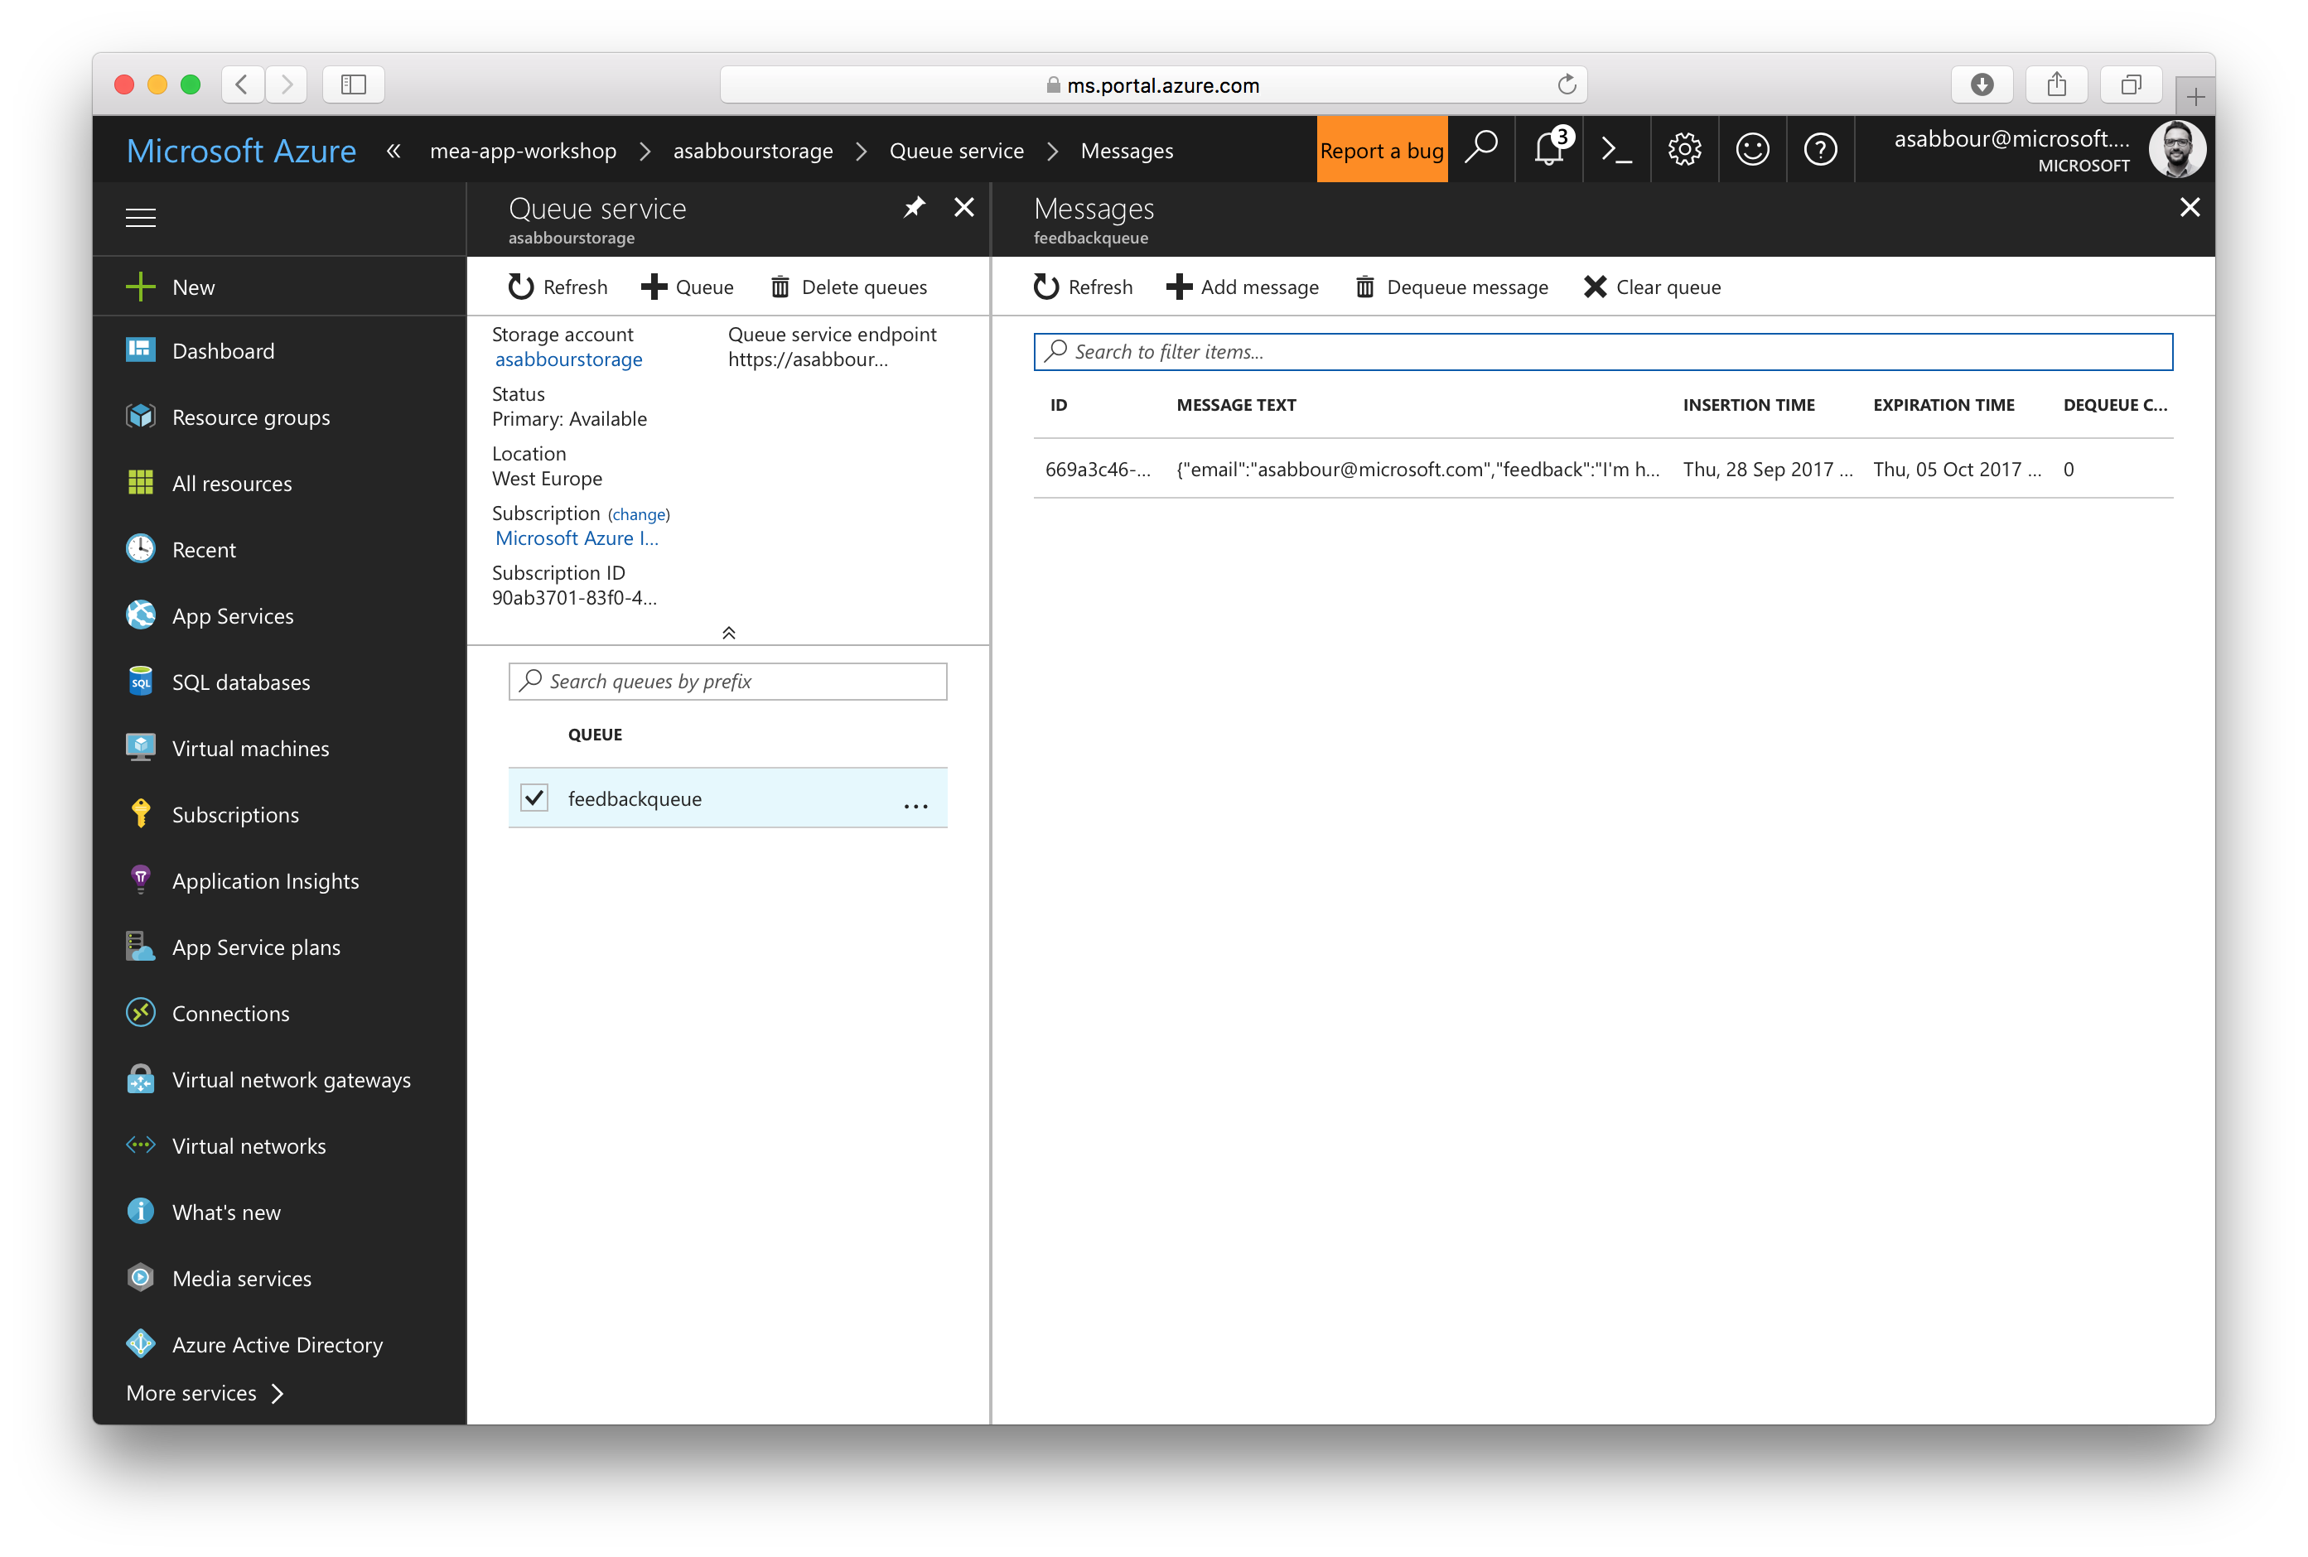

Slide 75
9.1 Create Function App to generate coupons
Use Consumption Plan as the hosting plan.
Choose the same resource group and region.
Choose the same storage account.

Slide 76


Slide 77
9.2 Configure the Function App
Setup deployment from your customerfeedback-functions Github fork.
Create App Settings with the below values:
BlobStorageConnection: blob storage connection string in the form of DefaultEndpointsProtocol=https;AccountName=[account name];AccountKey=[account key]

Slide 78
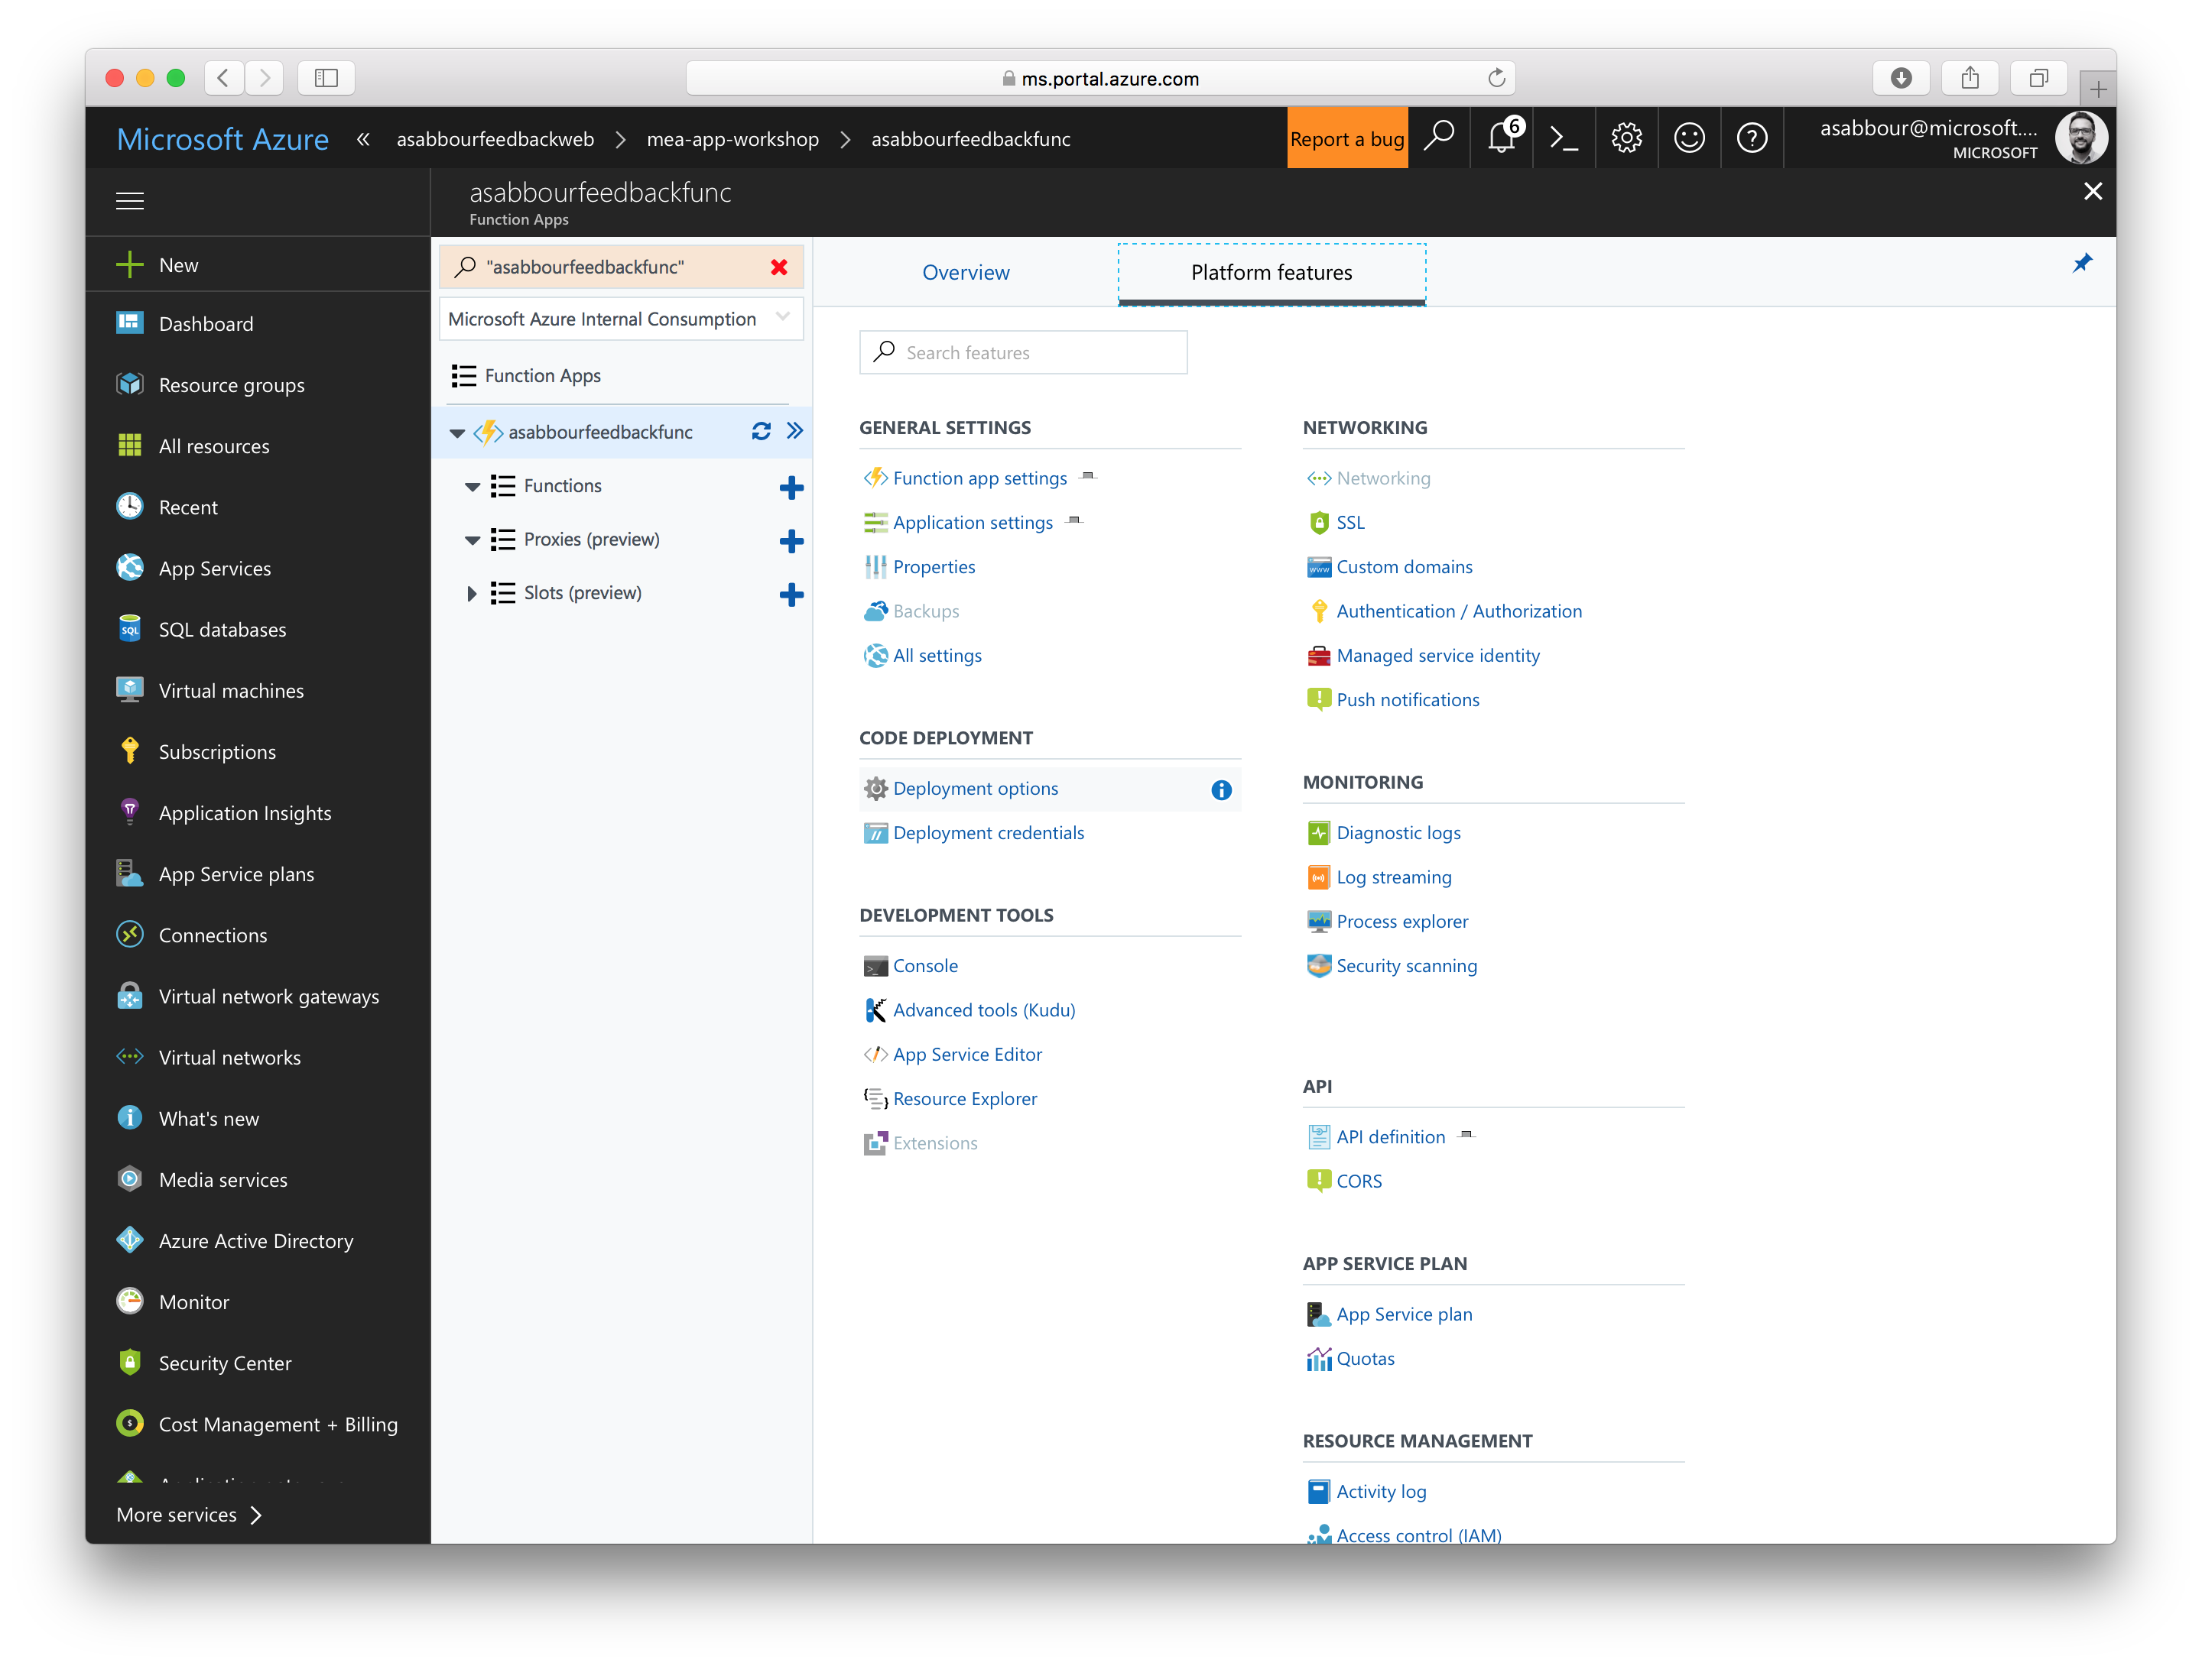

Slide 79
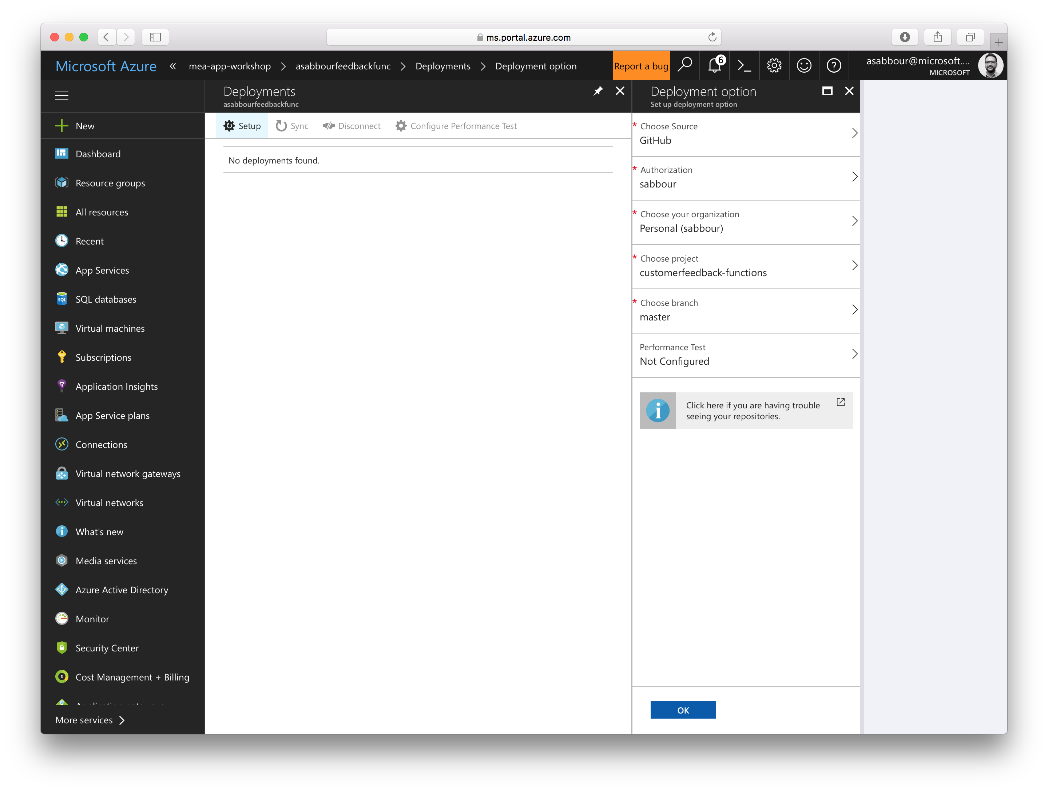

Slide 80
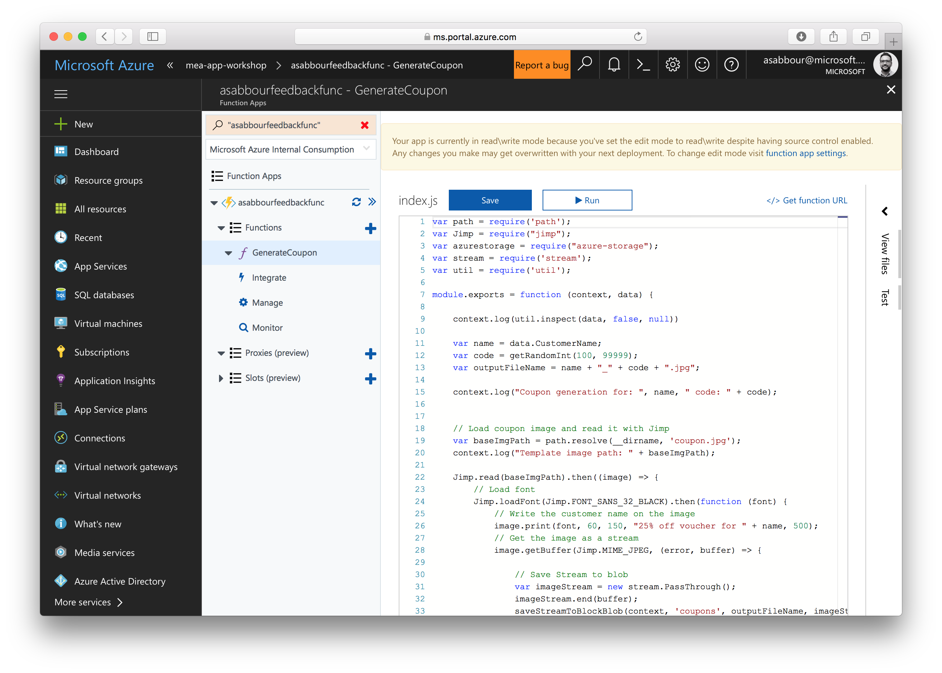

Slide 81
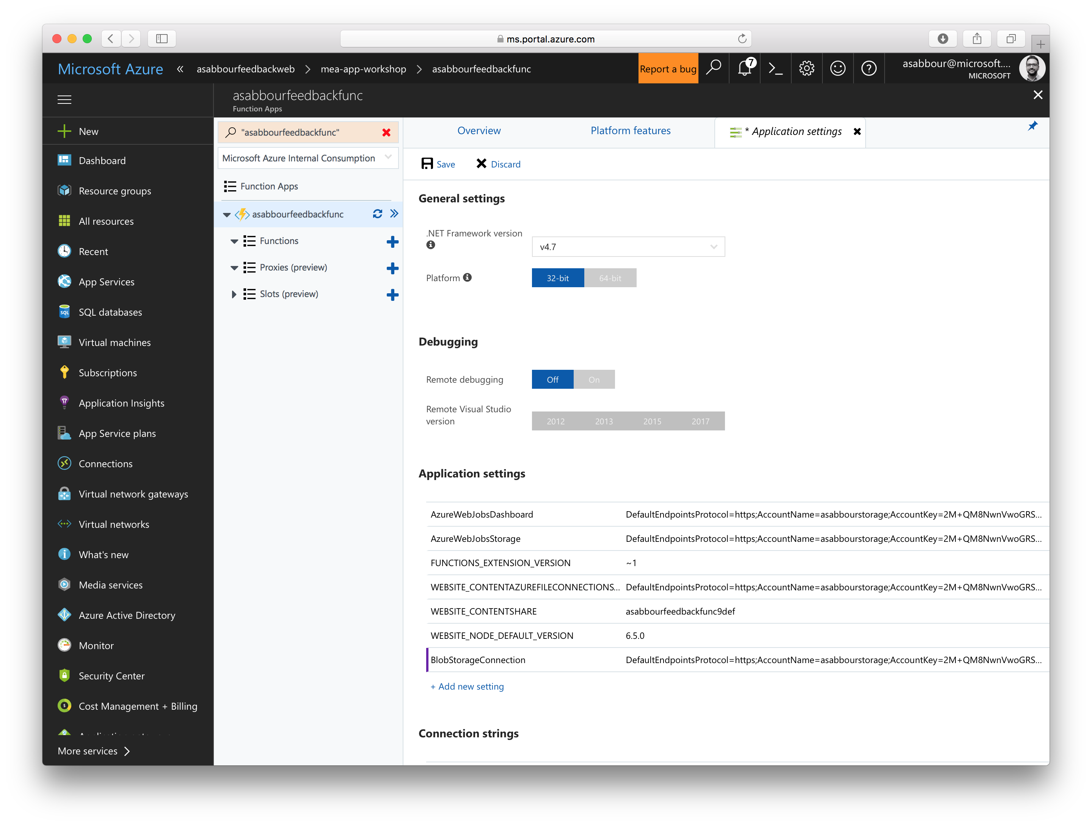

Slide 82
Importing Feedback API into API Management

Slide 83
10.1 Import Feedback API using Swagger
Import using OpenAPI specification
Point towards https://[alias]feedbackapi.azurewebsites.net/swagger.json
Give the API a suffix, e.g: crm
Wait for a few seconds, the interface should populate
Put the API in the Unlimited product
Once imported, change the Web Service URL to https://[alias]feedbackapi.azurewebsites.net
Test the API

Slide 84
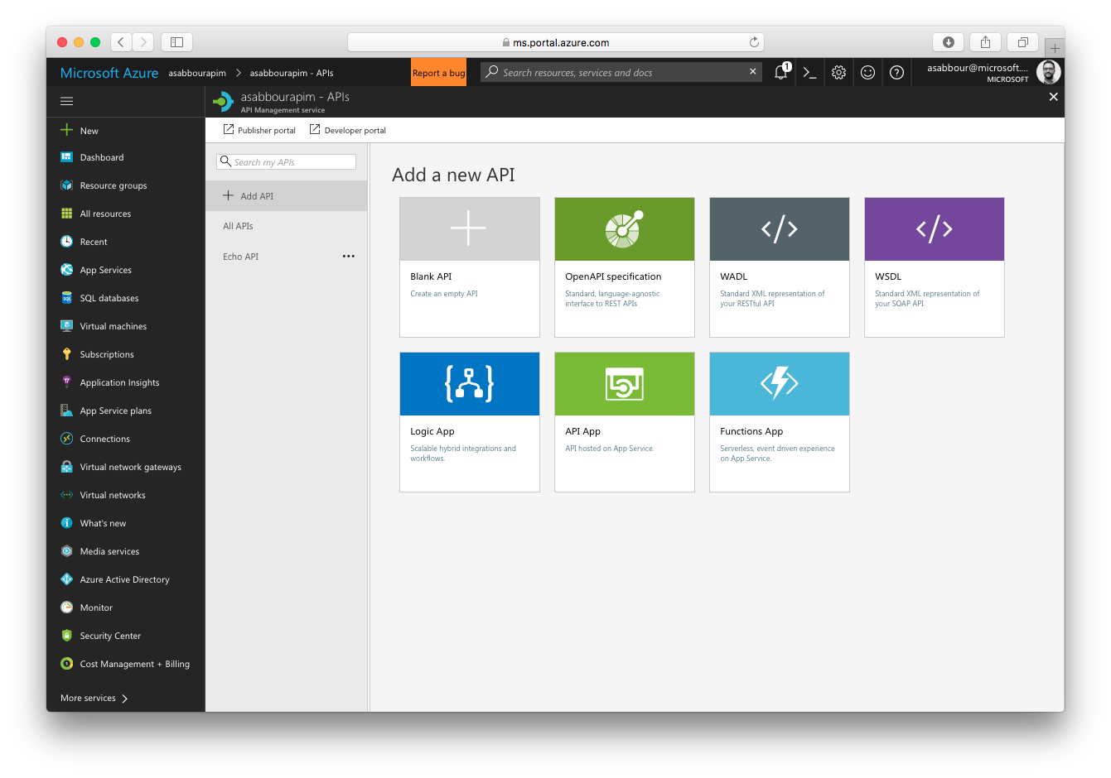

Slide 85
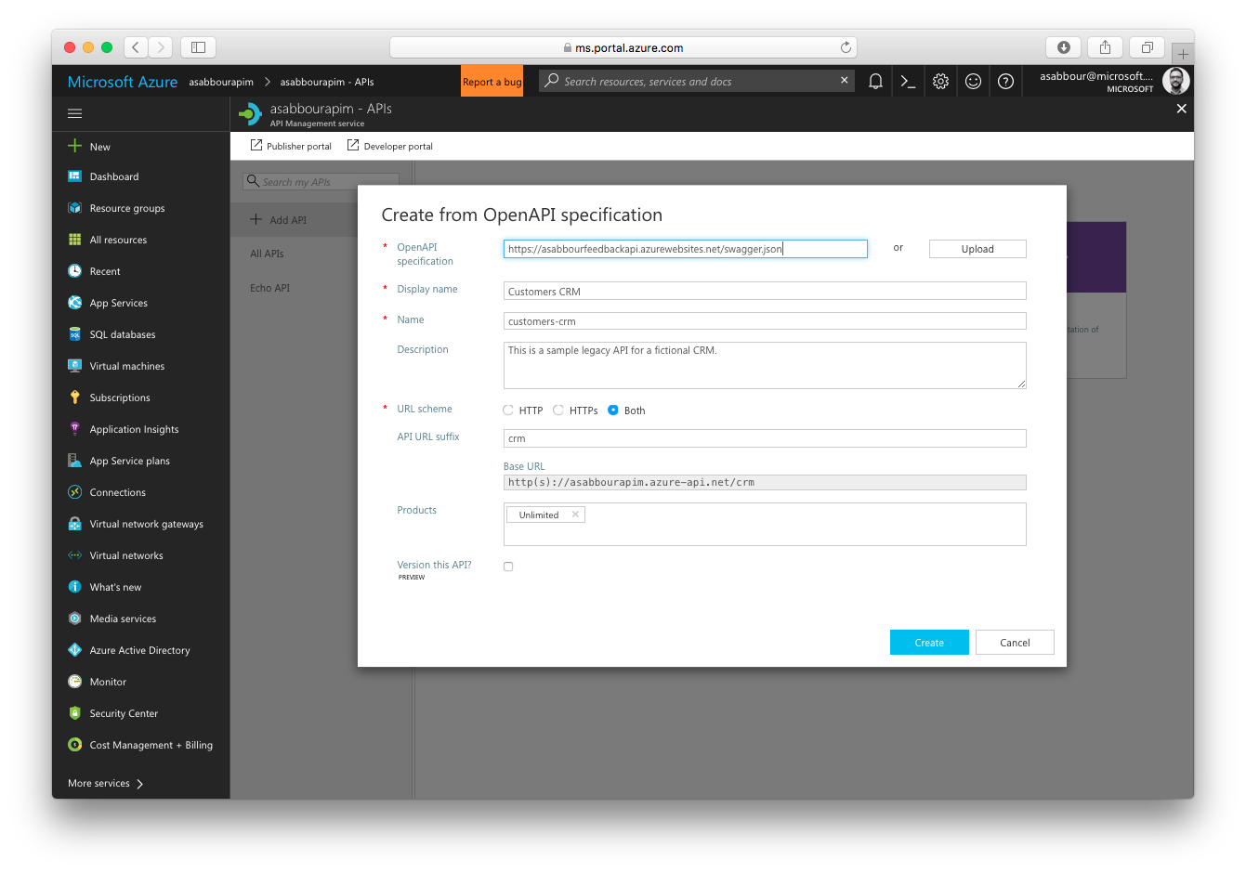

Slide 86
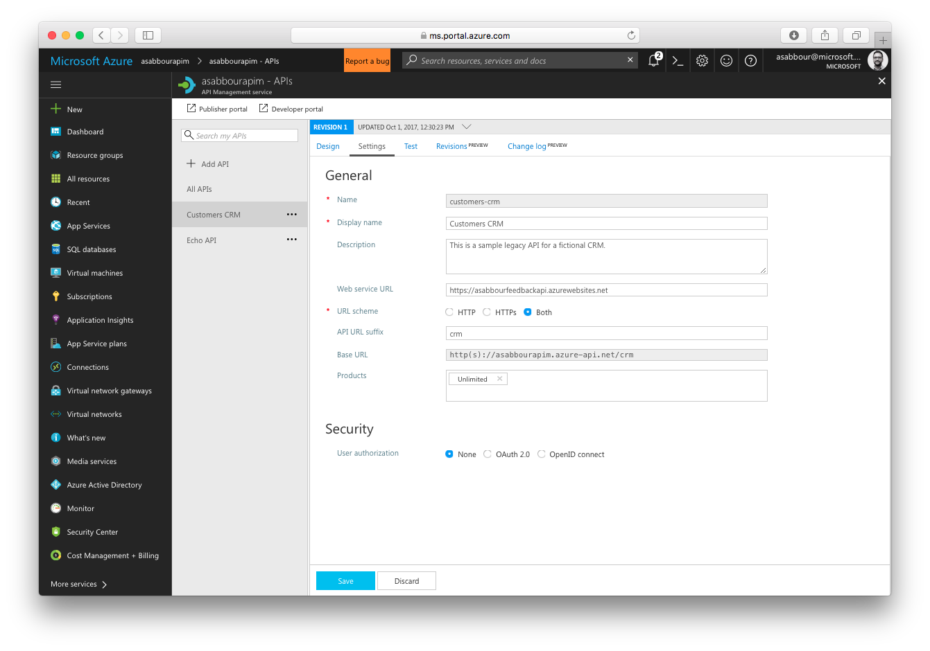

Slide 87
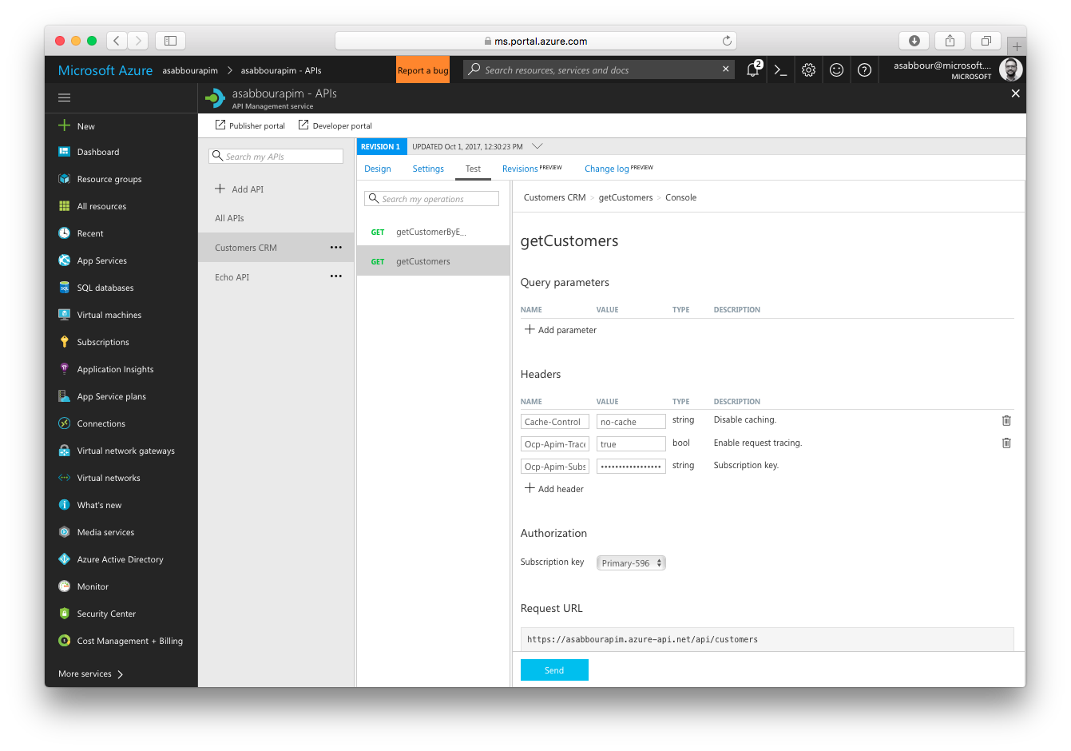

Slide 88
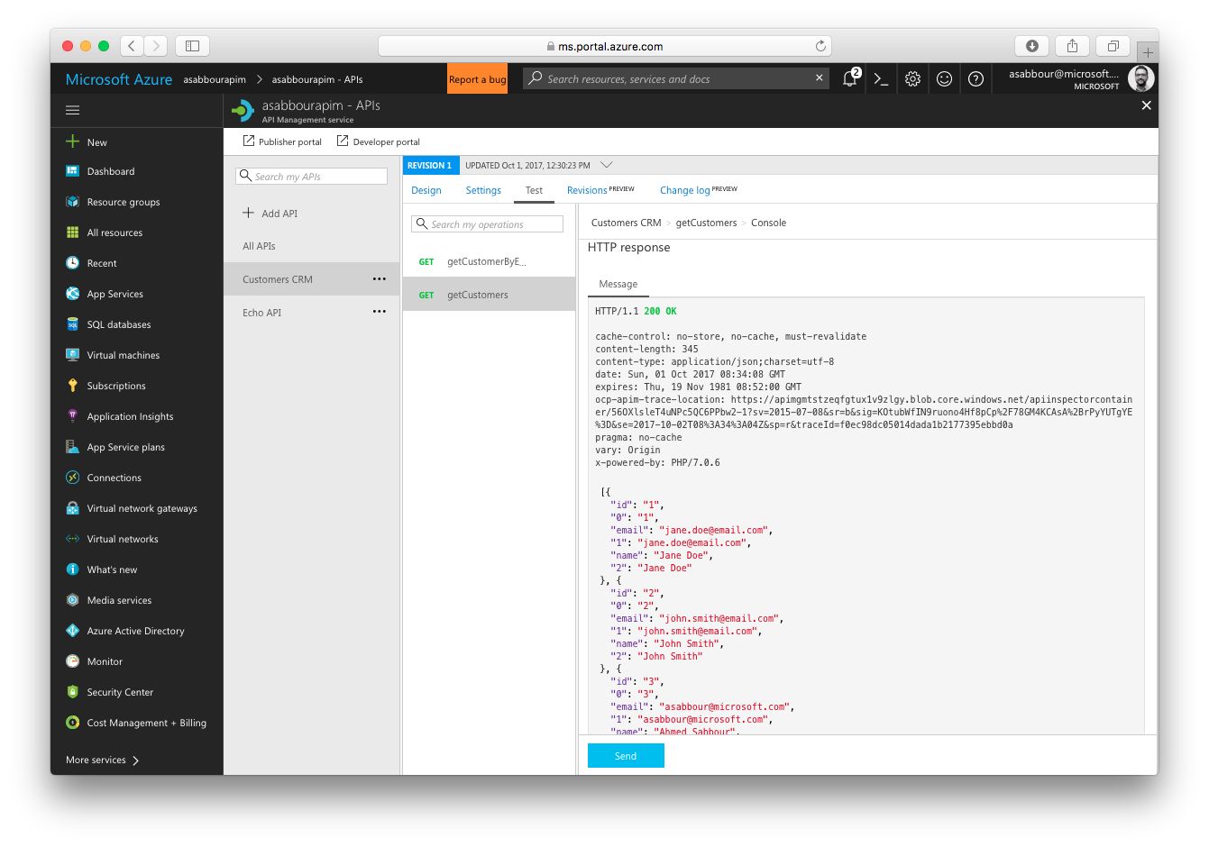

Slide 89
10.2 Obtain the subscription key for Unlimited product
Go to the Developer Portal
Click on Administrator -> Profile
Copy the Primary key of the Unlimited subscription and keep it aside, you’ll use it in the subsequent steps.
Notes:
596d8d4987144f0993a514499fcea956

Slide 90
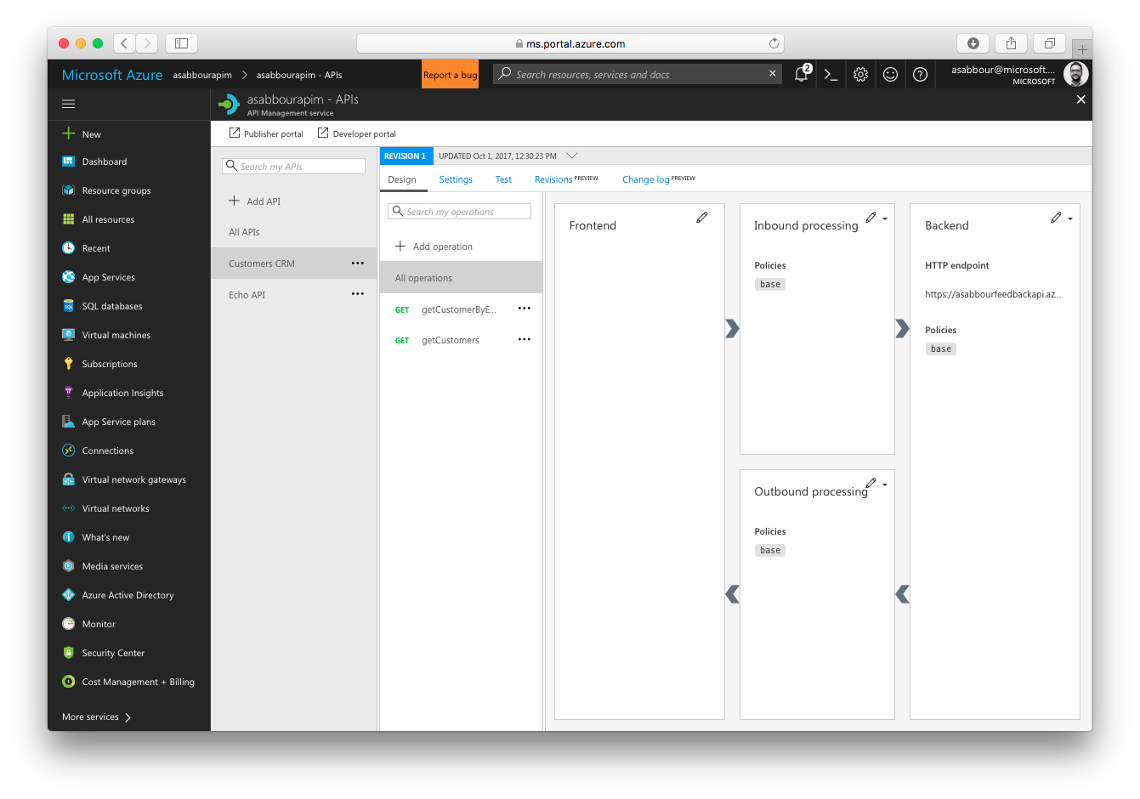

Slide 91
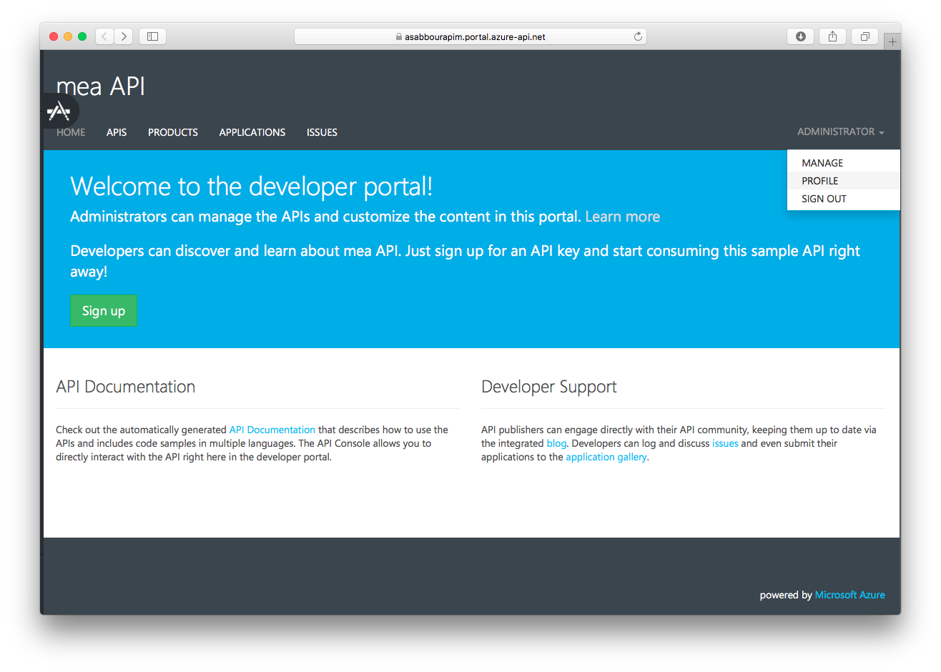

Slide 92
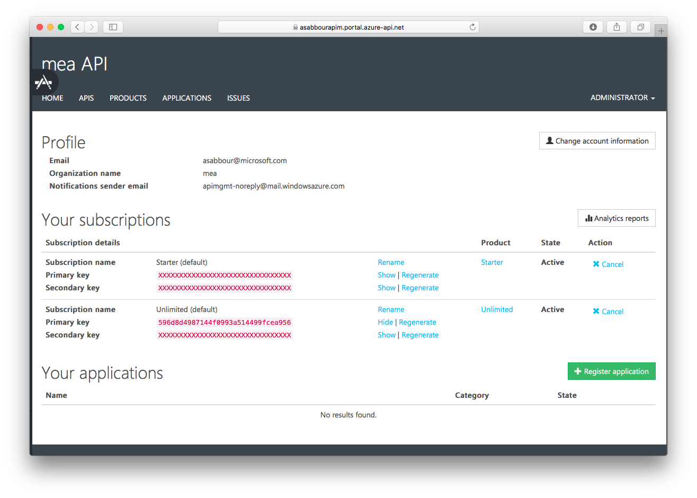

Slide 93

Lunch!
*
We start at 2:30 PM with the the integration workflow using Logic Apps
(* I don’t think we’re having Sushi for lunch)

Slide 94
Agenda
9:00
10:30
11:00
13:30
14:30
16:30
Scenario overview
Technology overview
[Coffee Break]
Preparing and deploying the solution
Importing APIs into Azure API Management
[Lunch Break]
Connecting solution with Logic Apps
Testing the solution and final thoughts
Finish

Slide 95
Integrating the solution using Logic Apps

Slide 96
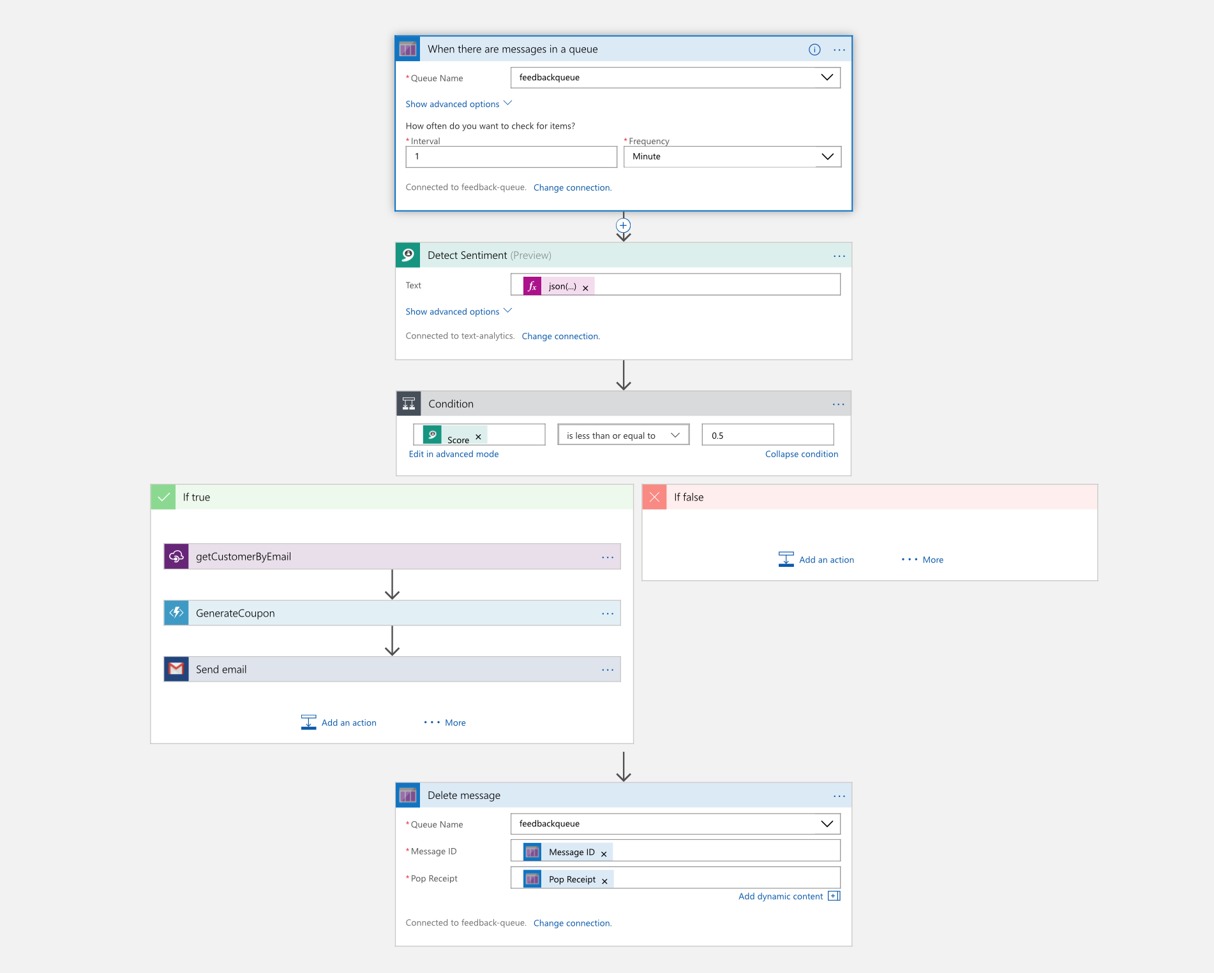
Full Logic App diagram You’ll build it step by step

Slide 97
11. Create Logic App
Give it a unique name, like [alias]feedbacklogic
Choose the same resource group and region.

Slide 98
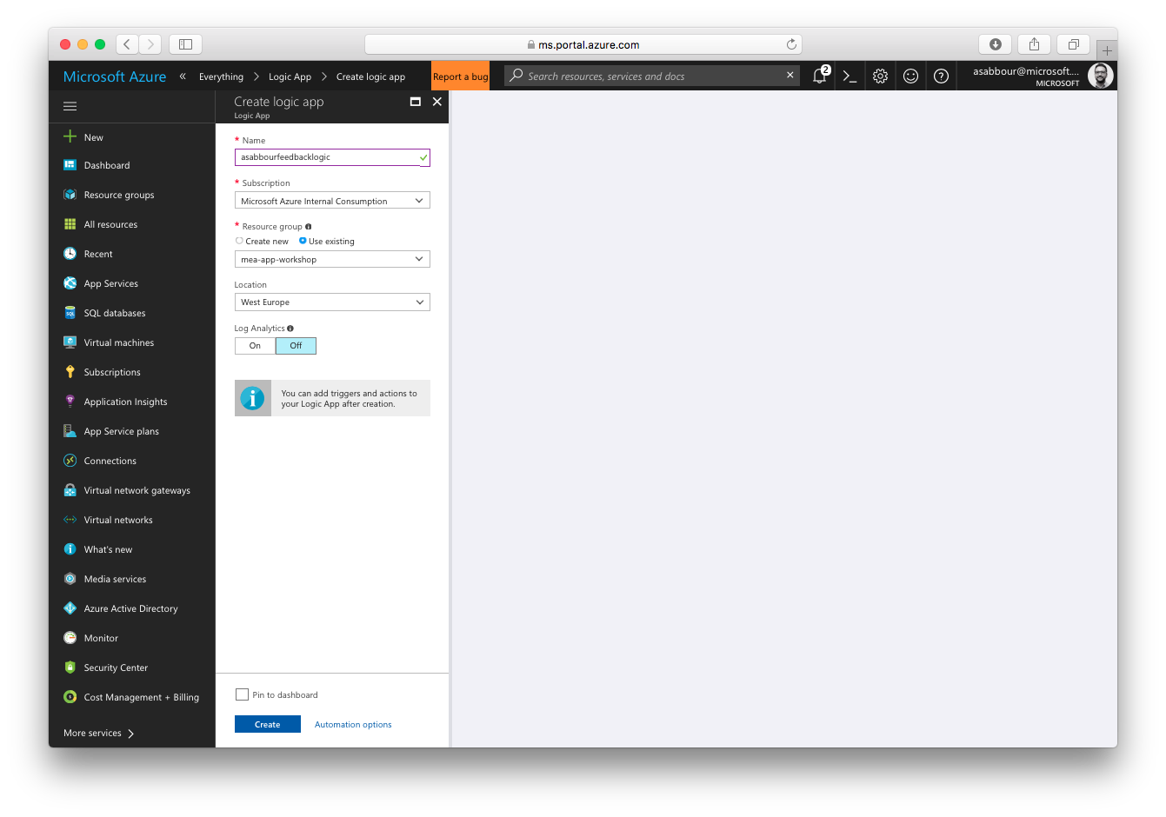

Slide 99
12.1 Create the workflow
Open the Logic Apps Designer
Start from a Blank Logic App template

Slide 100
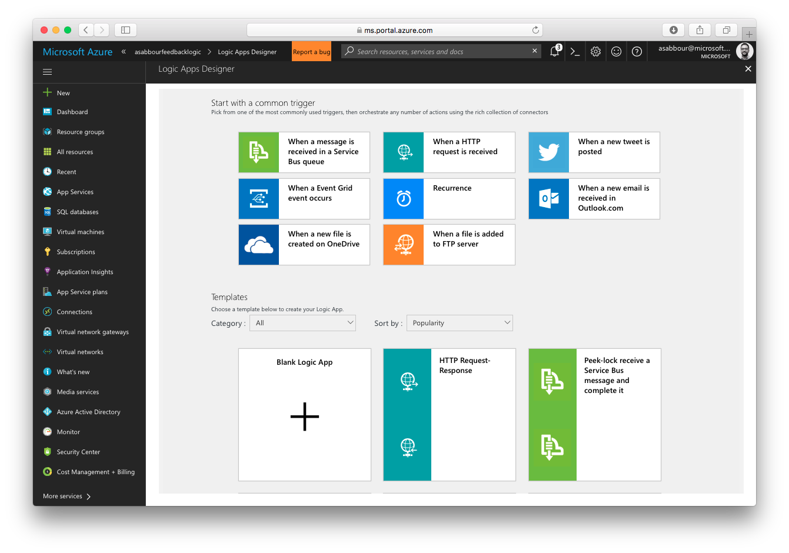

Slide 101
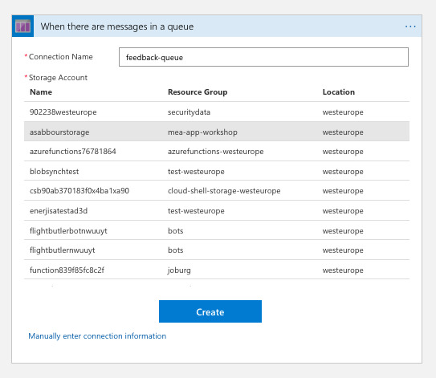
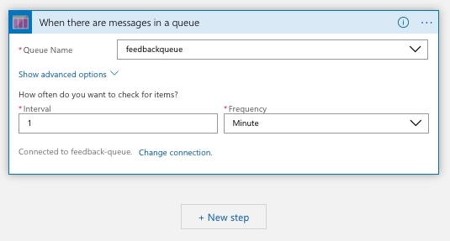
12.2 Add queue trigger
Add a new Queue trigger, pointing to your storage account created earlier

Slide 102
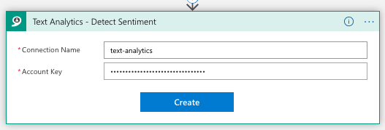
12.2 Add Text Analytics action
Add a Text Analytics action to detect sentiment
Provide the Cognitive Services account name and key
Configure the text field to be @{json(triggerBody()?['MessageText']).feedback}

Slide 103
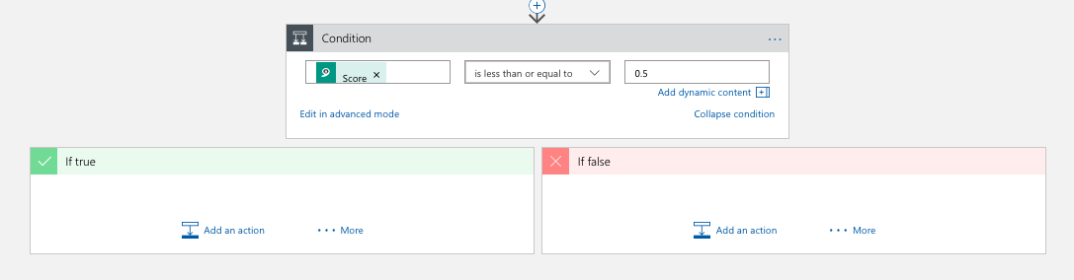
12.3 Add condition, when the sentiment is negative
When the score is less than or equal to 0.5
This is a negative sentiment
When this is true, add the next action to get customer details

Slide 104
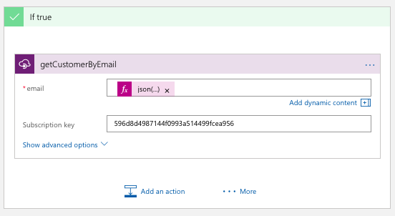
12.4 Add API Management action
Query API Management for customer name by email
Use this as the value of the email field, it will extract it out of the message on the queue: @{encodeURIComponent(json(triggerBody()?['MessageText']).email)}
Provide the API Management subscription key

Slide 105

12.5 Add Generate Coupon Azure Function action
Call the Generate Coupon function, passing in the customer name returned from the API Management call

Slide 106

12.6 Add Email action
Use your favorite email action to send an email to the customer with the coupon link
Configure it with the email, name and Coupon URL obtained from the previous actions.
You may use this as the body of the email action: Dear @{body('getCustomerByEmail')['name']}, we want to make it up to you. Here is a coupon: @{body('GenerateCoupon').CouponUrl}

Slide 107

12.7 Delete the message from the queue
Now that you’ve processed this message, delete it from the queue to avoid processing it again. Configure with queue name, message ID and pop receipt ID from the original trigger.

Slide 108
Full Logic App diagram don’t forget to save!

Slide 109
Testing the solution

Slide 110



Bonus (CDN): https://[alias]feedbackcdn.azureedge.net/coupons/Ahmed Sabbour_89232.jpg?<sas_token>

Slide 111
Closing - 3 questions to you!
Did you enjoy it?
Does it show value to your customers?
Can you deliver it with every customer you have?
123.

Slide 112
Resources
Scenario on Github (presentation + handouts)
http://github.com/sabbour/customerfeedback
Try App Service (no subscription required) http://aka.ms/tryappservice Try DevOps (no subscription required) http://aka.ms/trydevops

